Slide 1
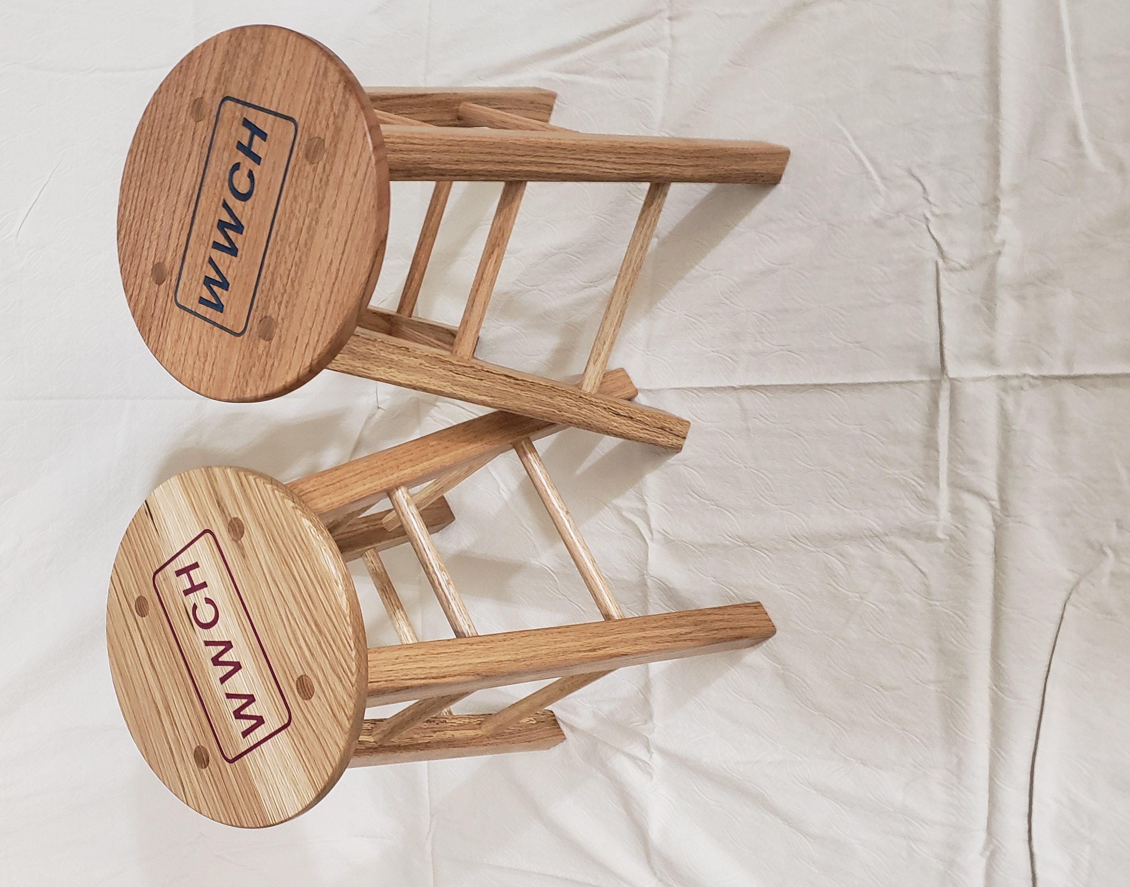
Two Shop Stools

Slide 2
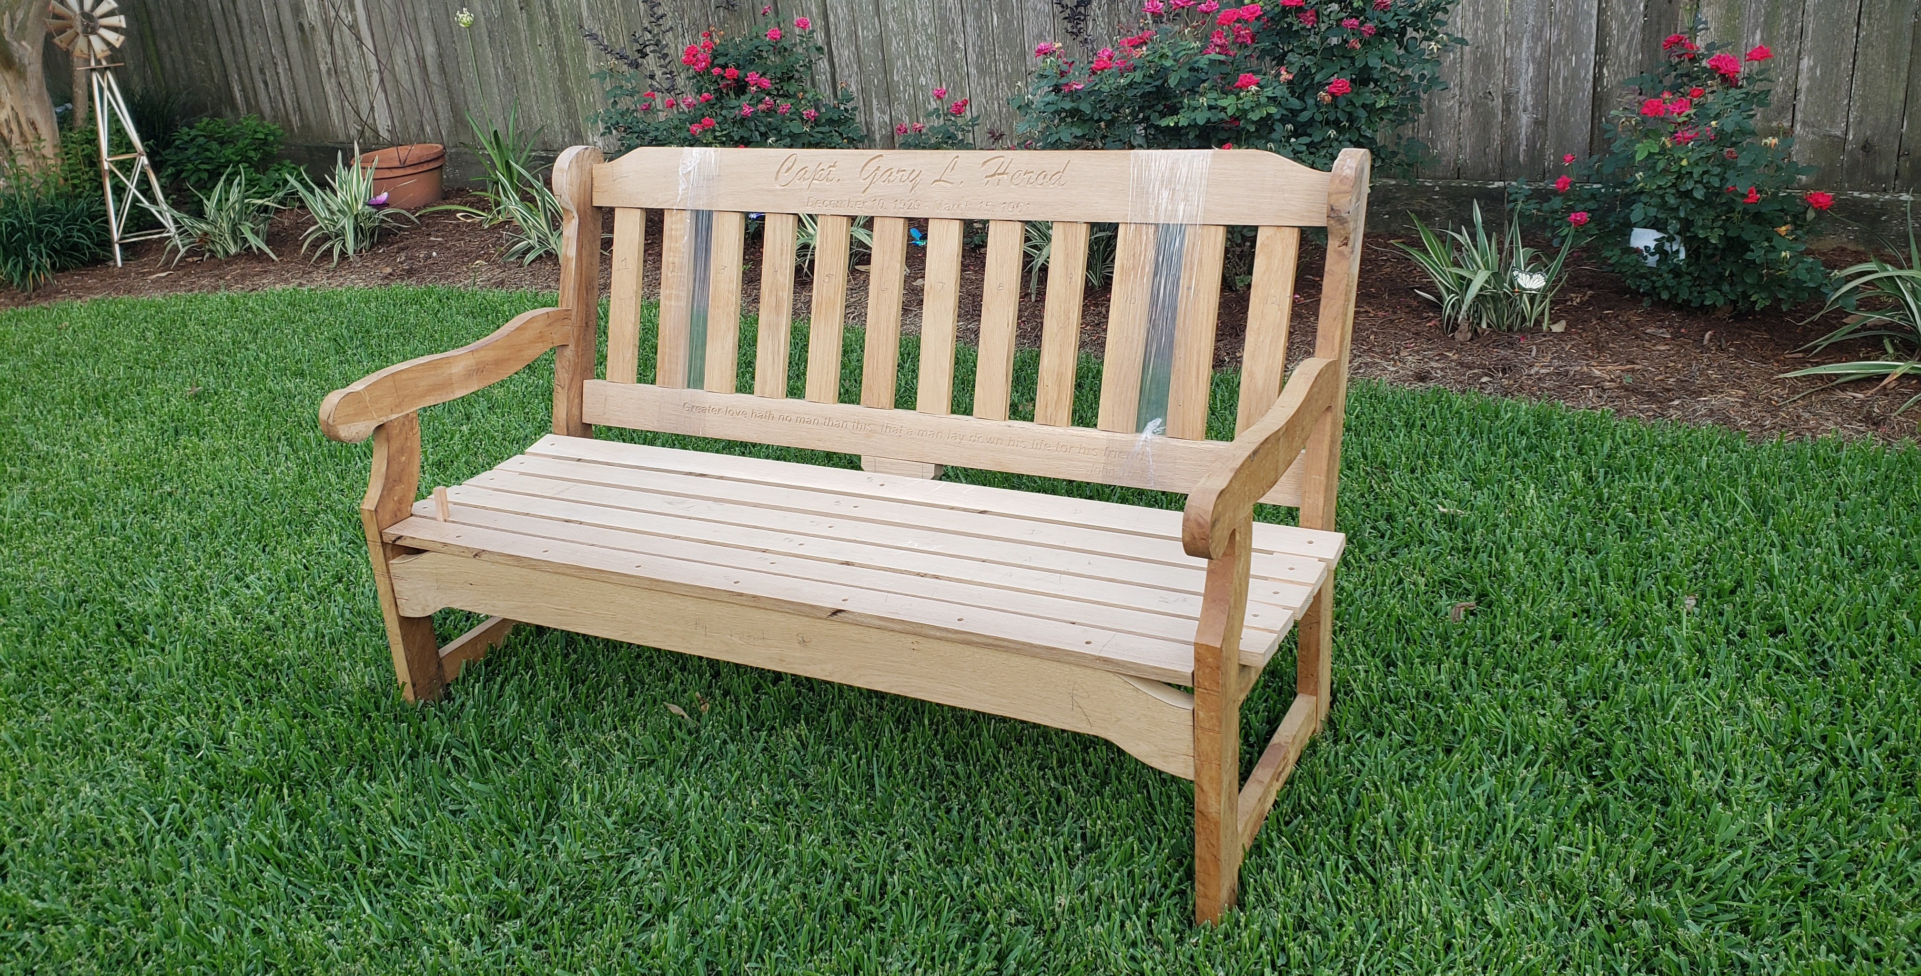
MEMORIAL BENCH

Slide 3
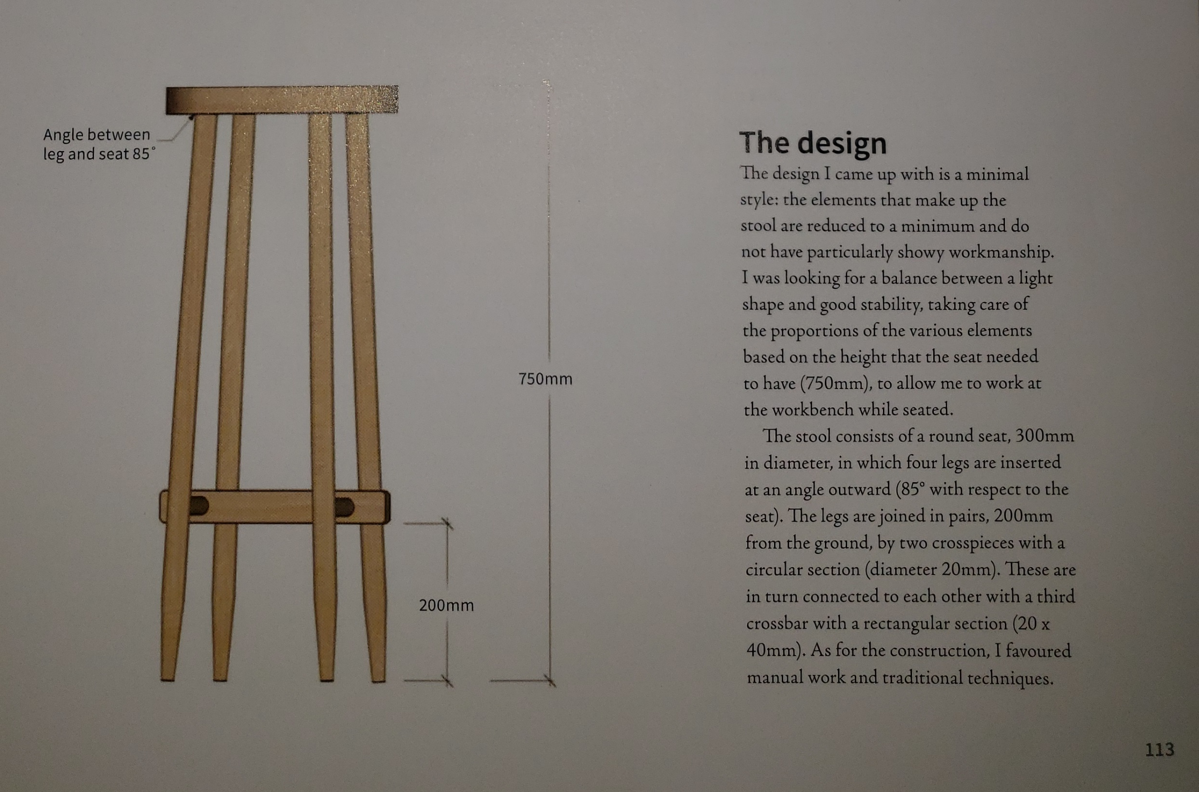
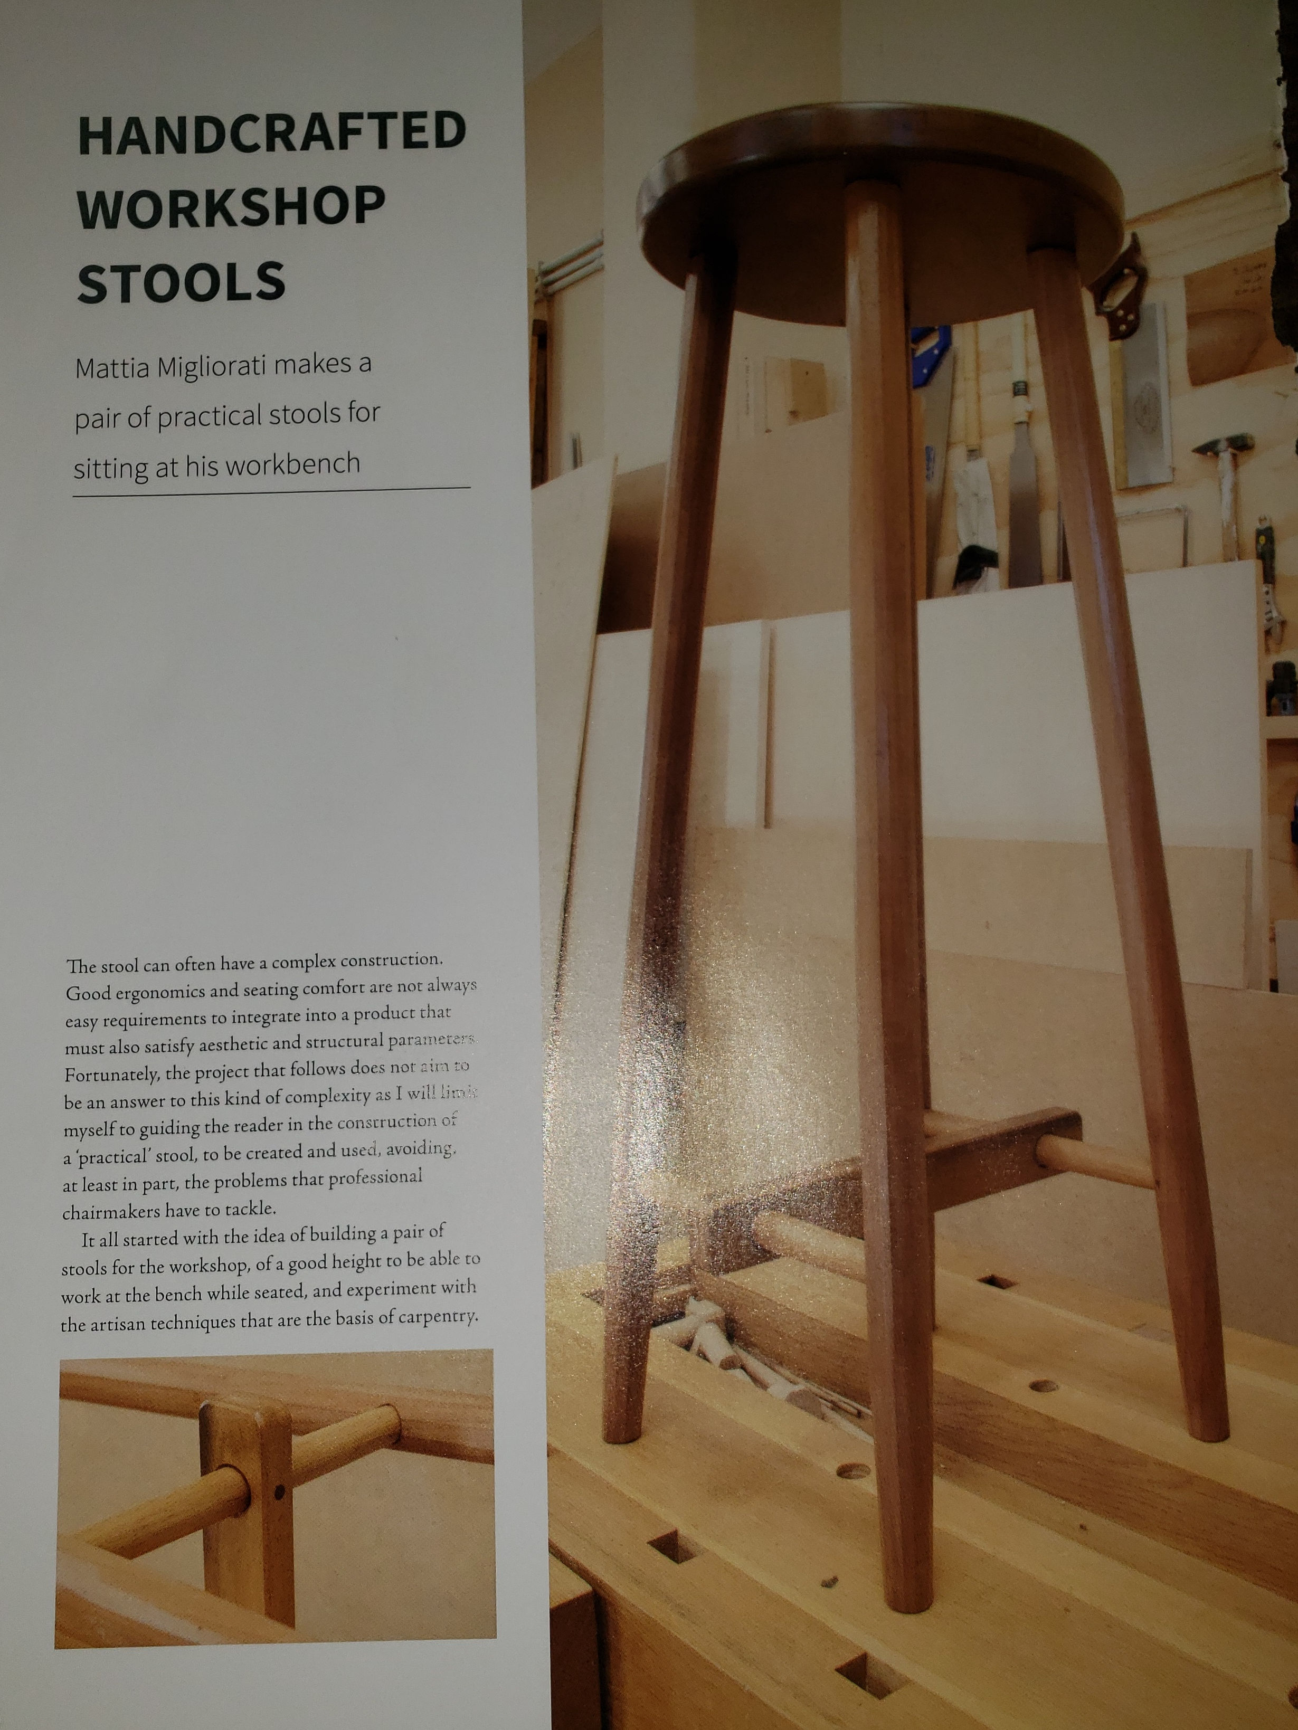
PROPOSAL

Slide 4
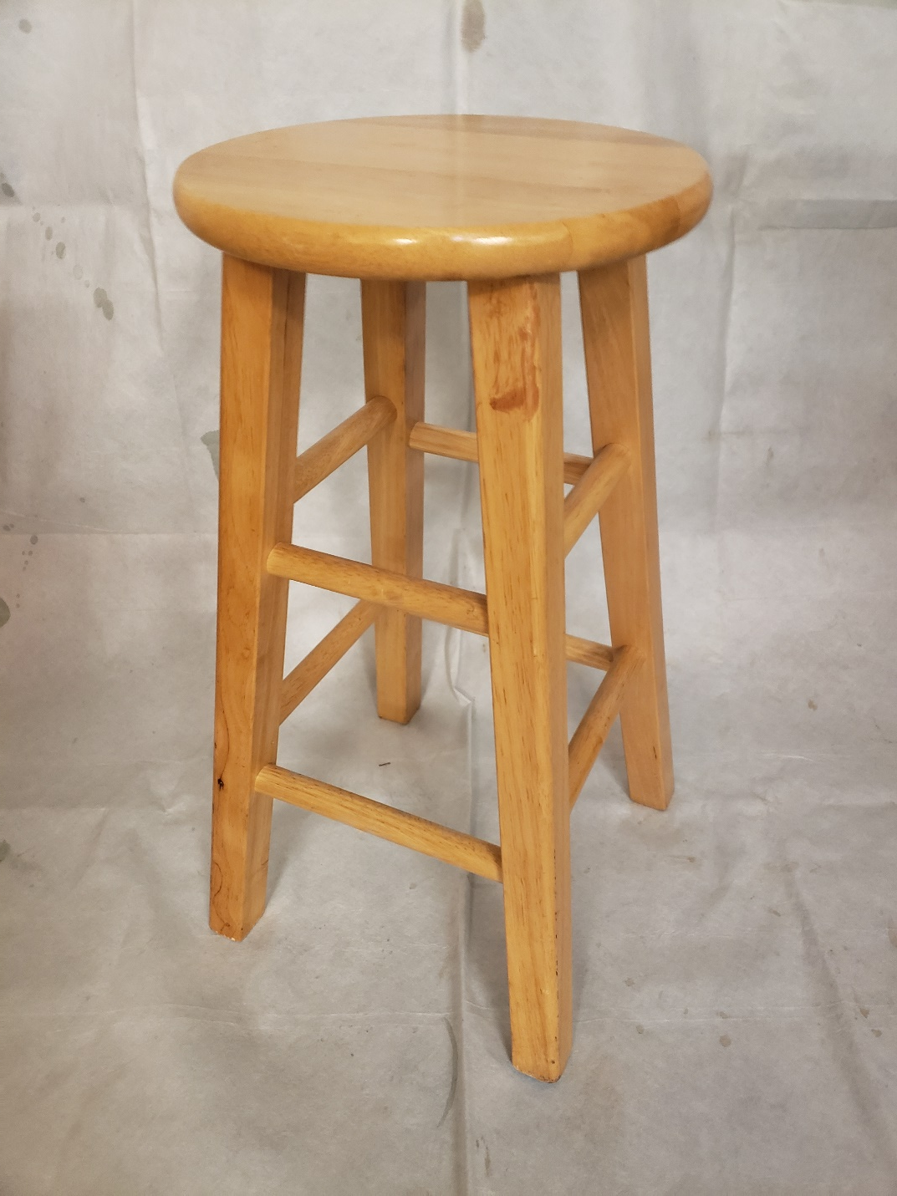
Prototype

Slide 5
Determining Dimensions

Slide 6
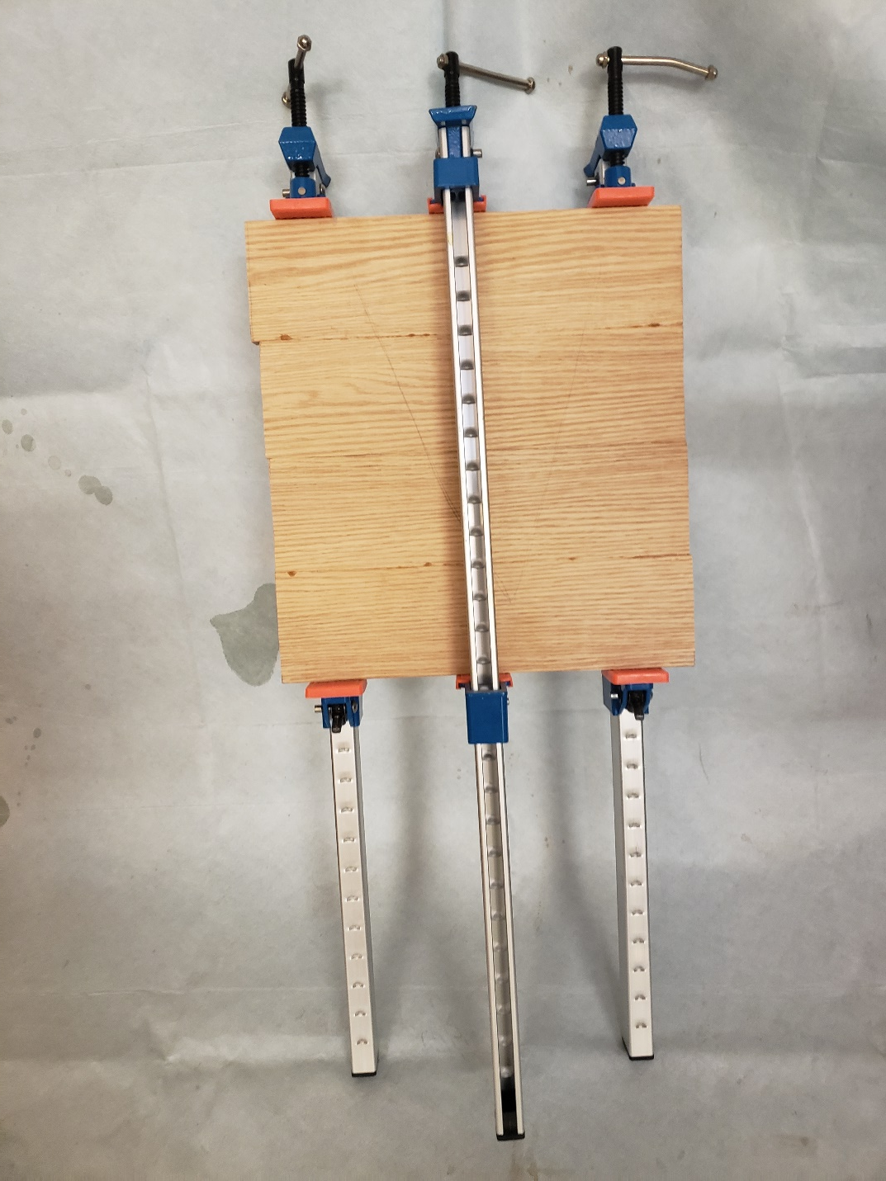
Edge-Glued Panel Top

Slide 7
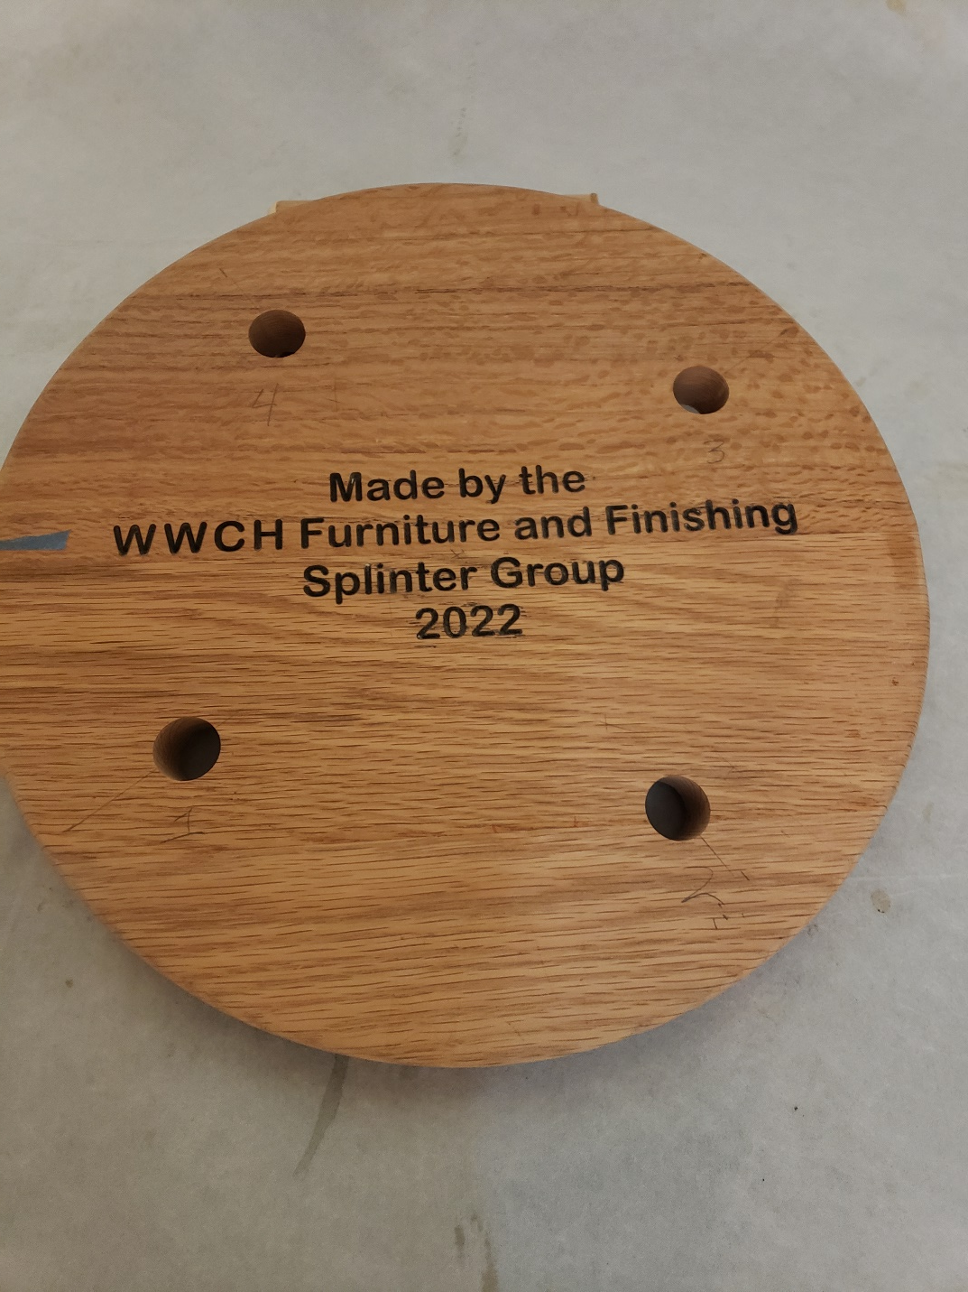
CNC Work to Form Top, ENGRAVE LOGO & SPLINTER GROUP CREDIT

Slide 8
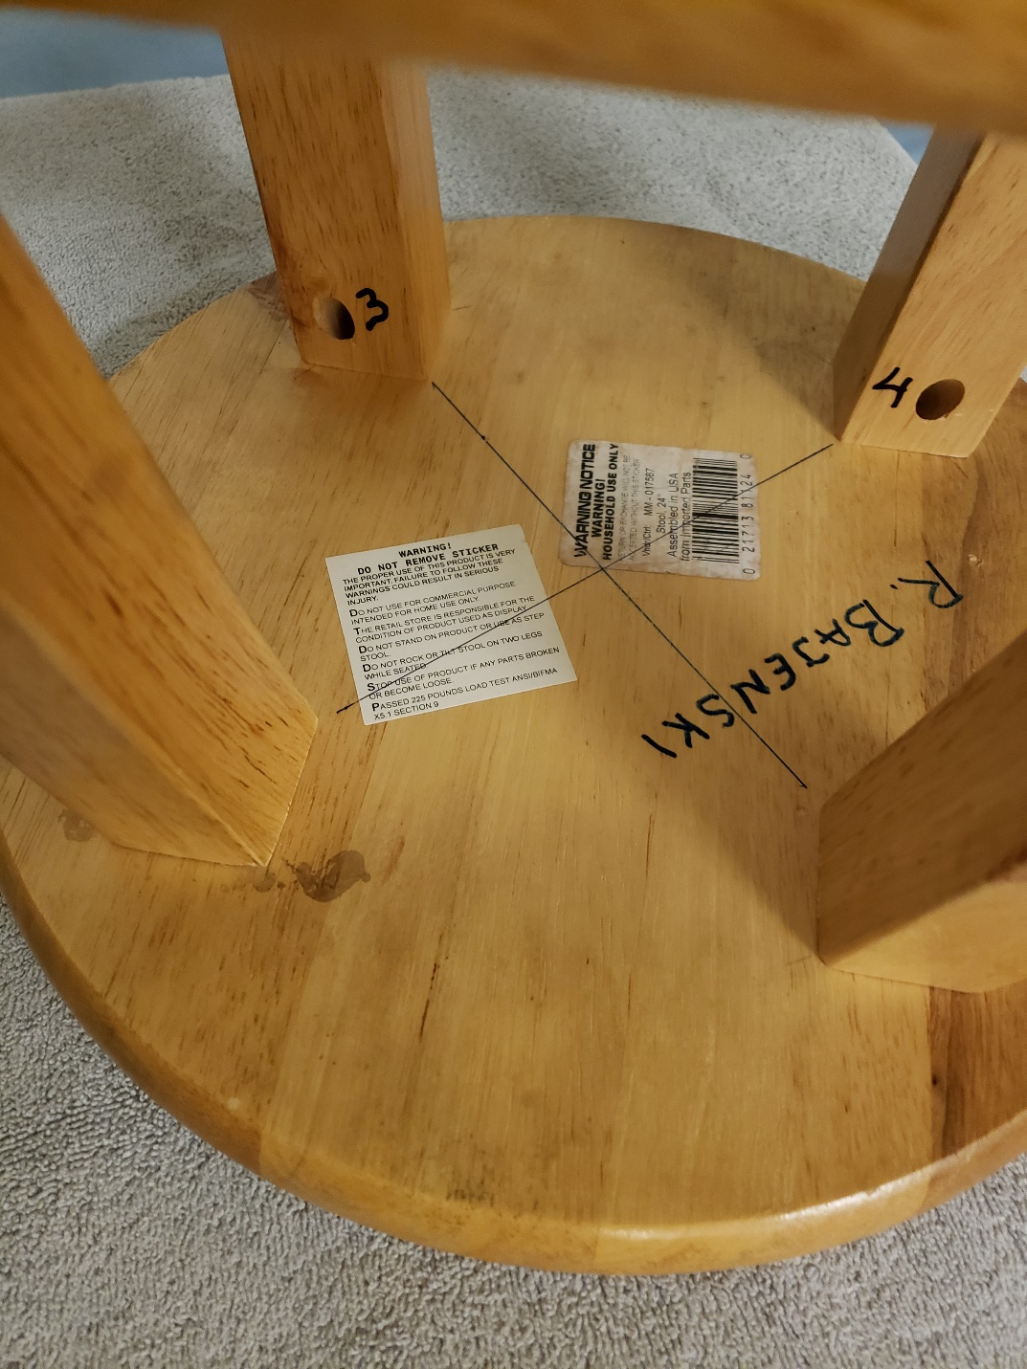
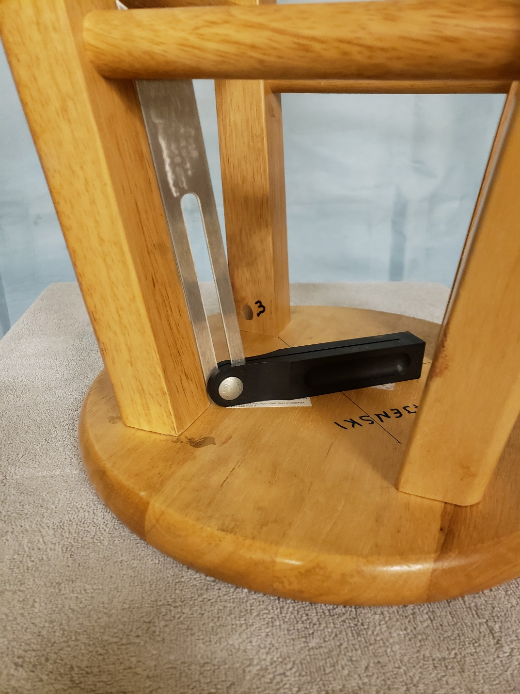
Determining Seat-to-Leg Angle

Slide 9
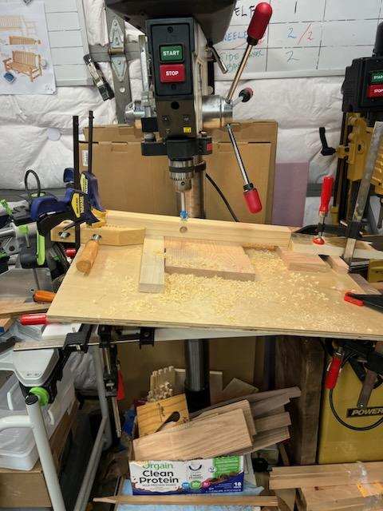
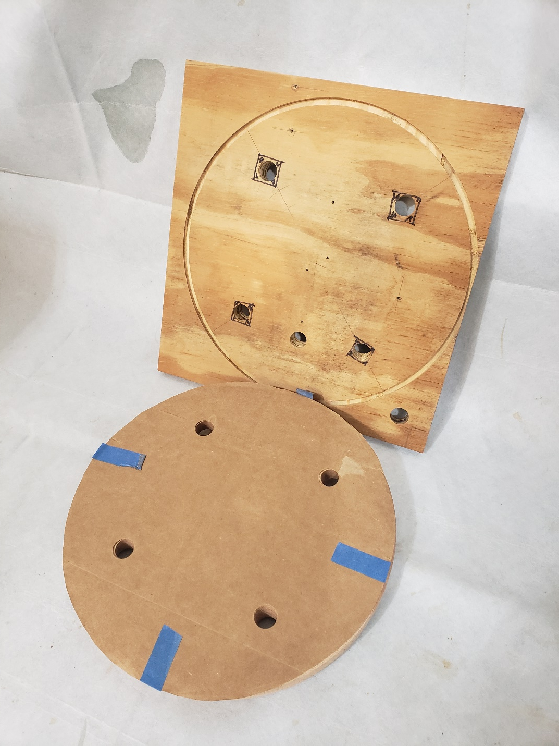
Trial Board & Angle drilling

Slide 10
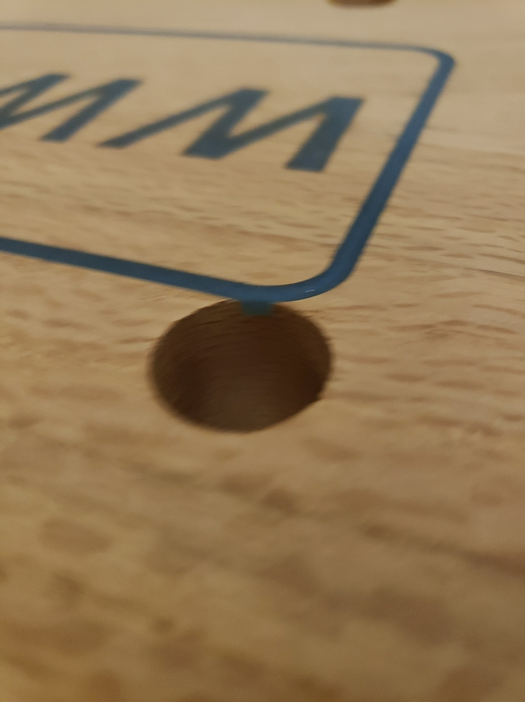
Oops!

Slide 11
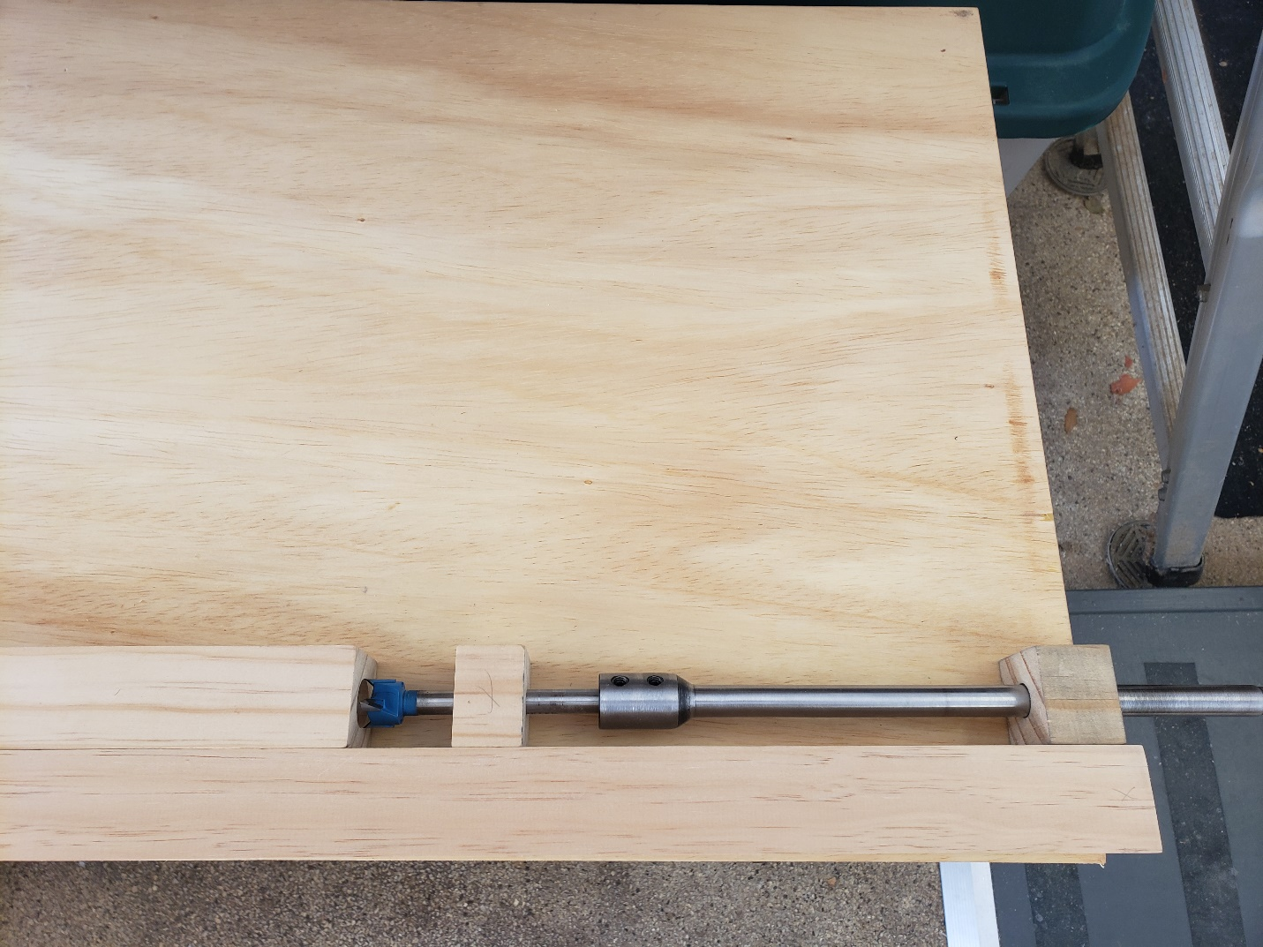
Drilling Loose Tenons for Legs

Slide 12
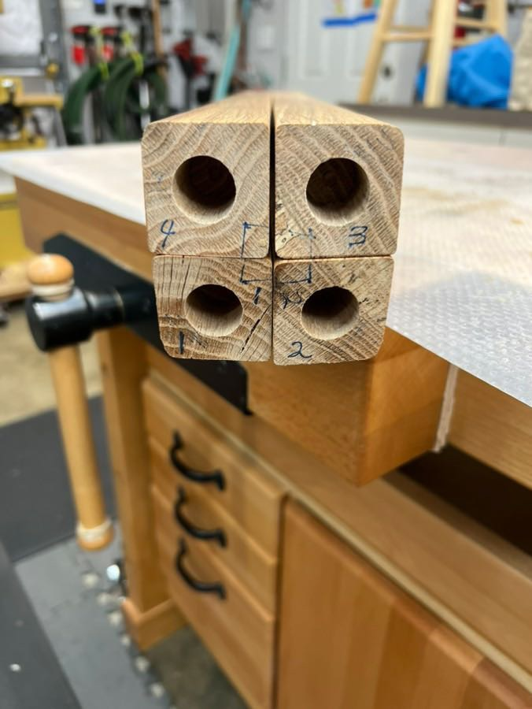
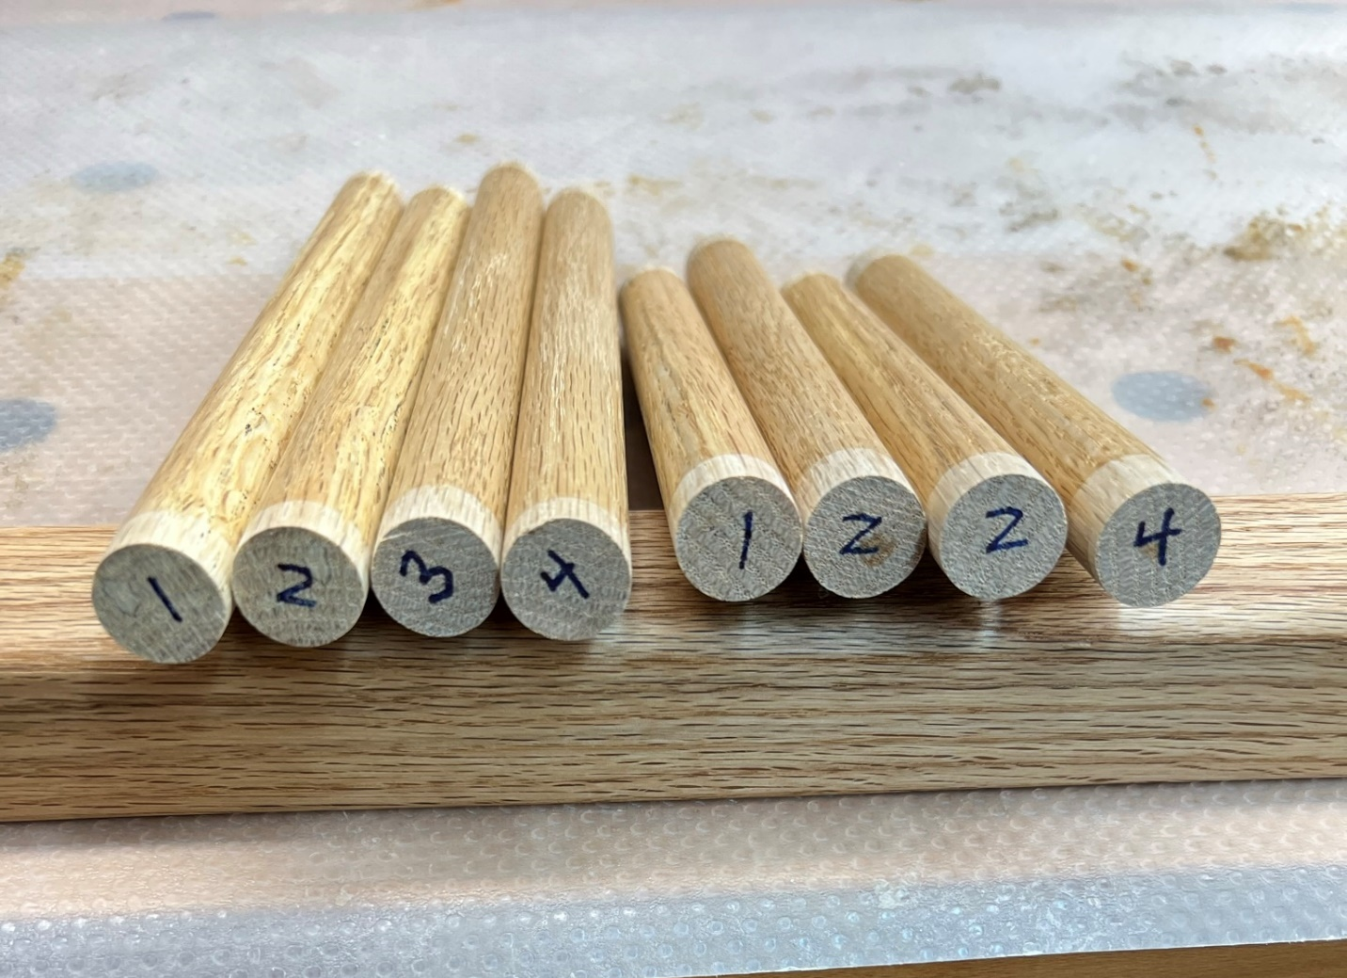
Numbering & Color Coding parts

Slide 13
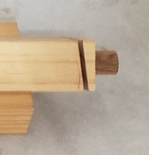
Table Saw Jig for Cutting Leg-to-Seat Angle

Slide 14
Stretchers from Dowels

Slide 15
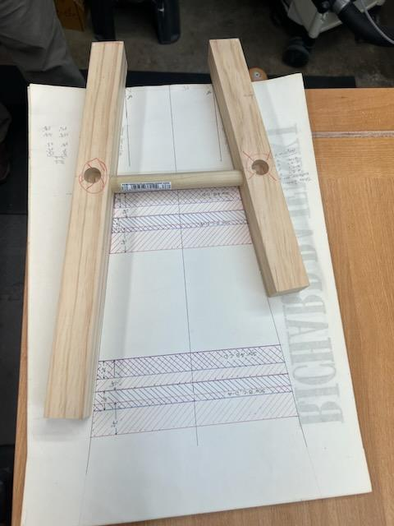
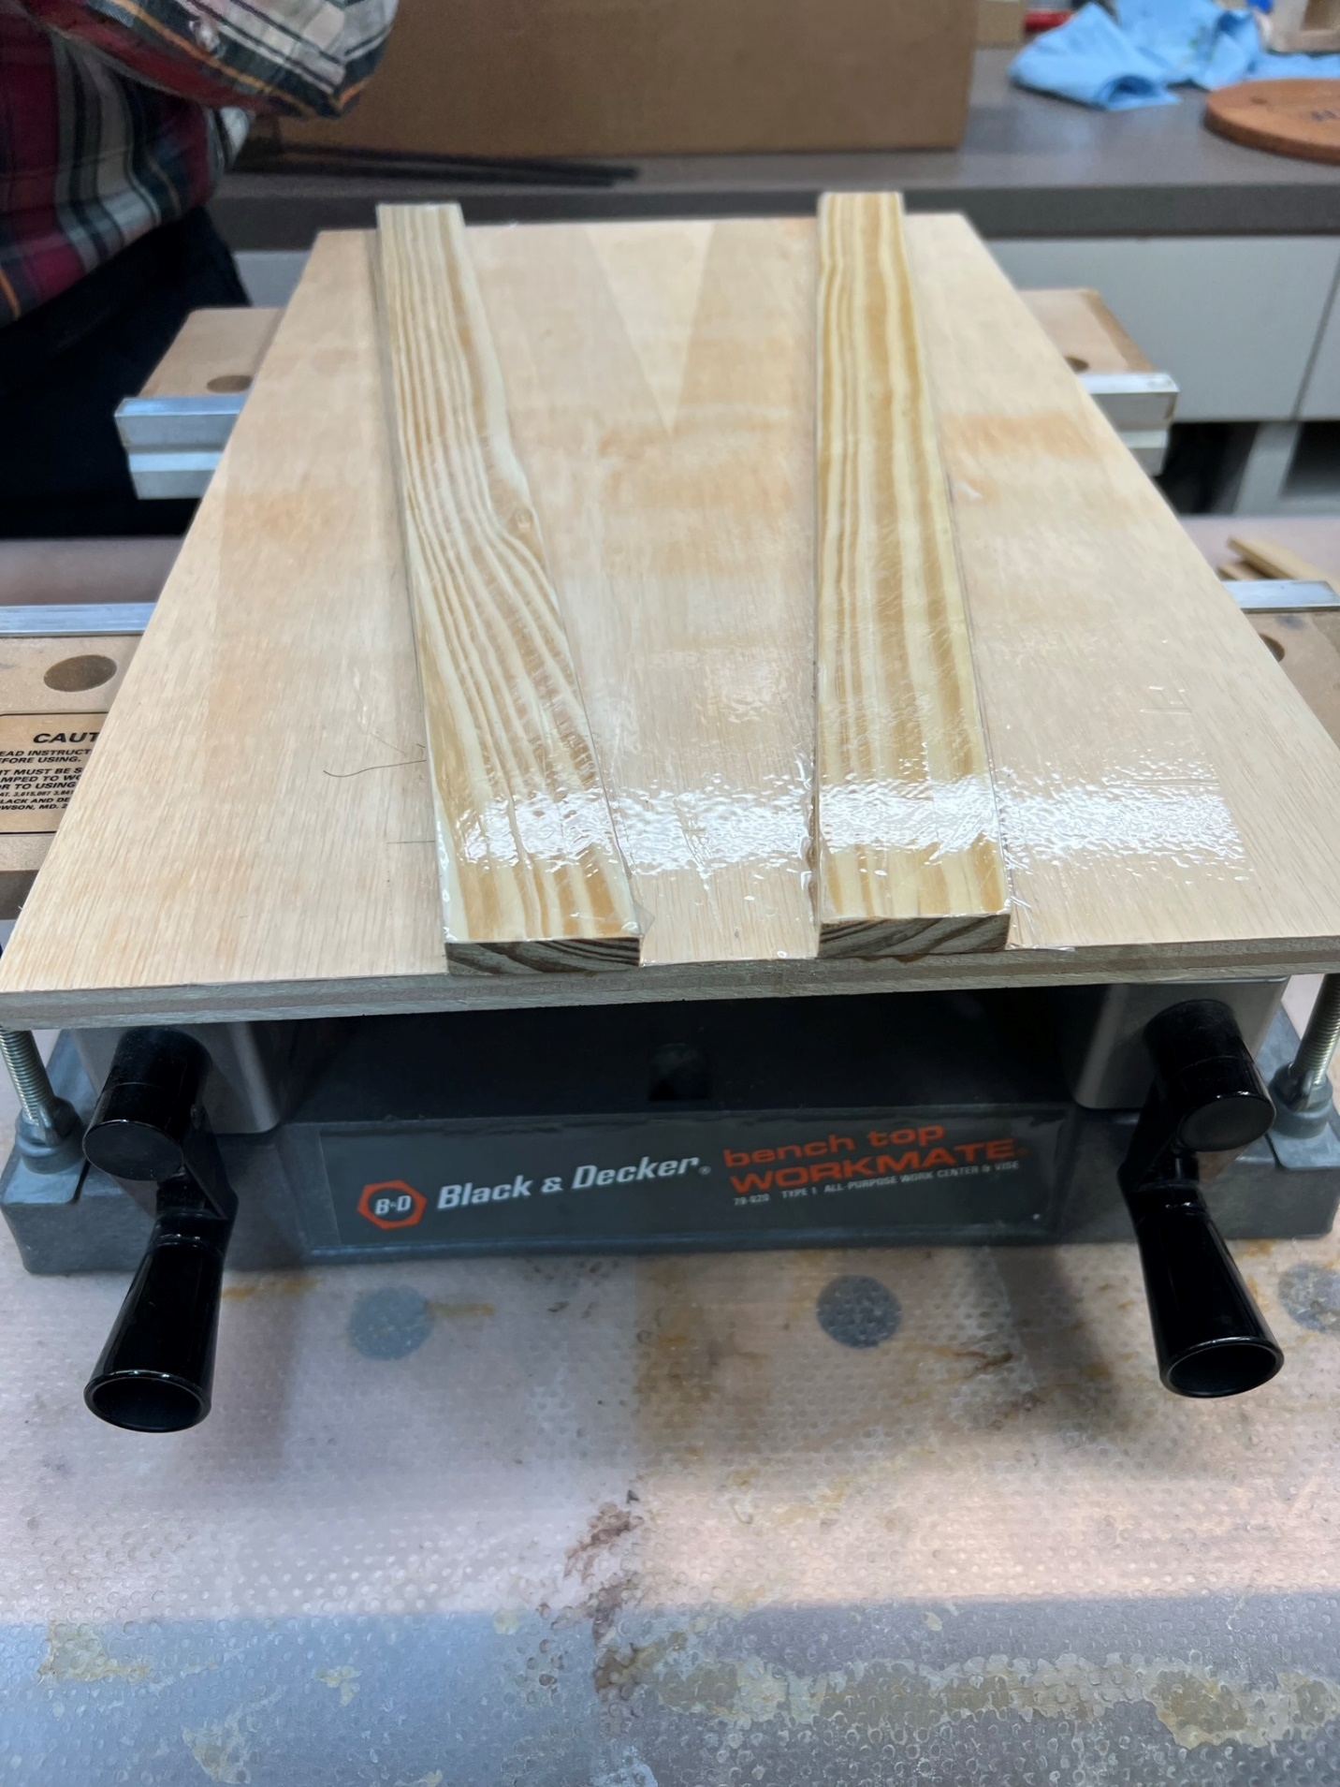
Leg Subassembly Alignment jig

Slide 16
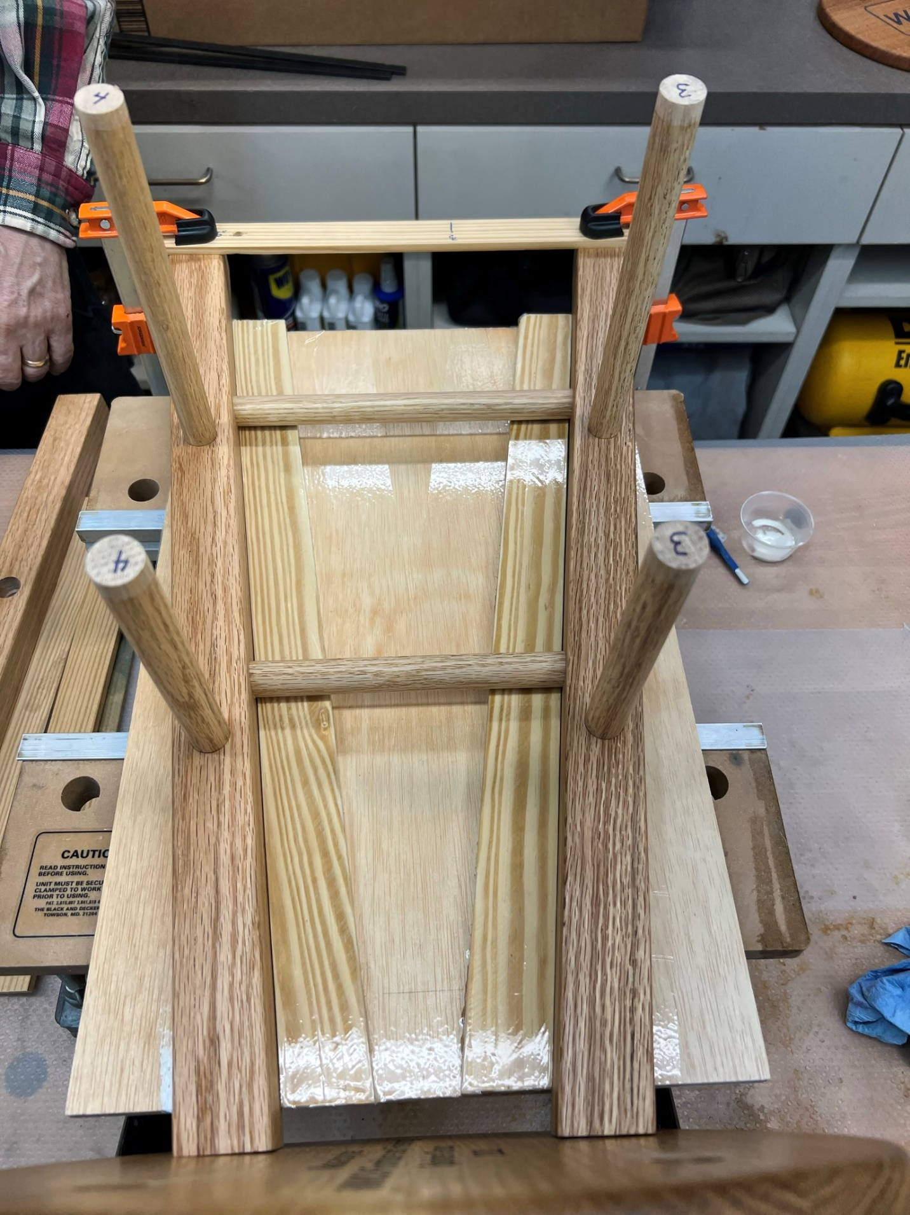
Leg Subassembly Alignment

Slide 17
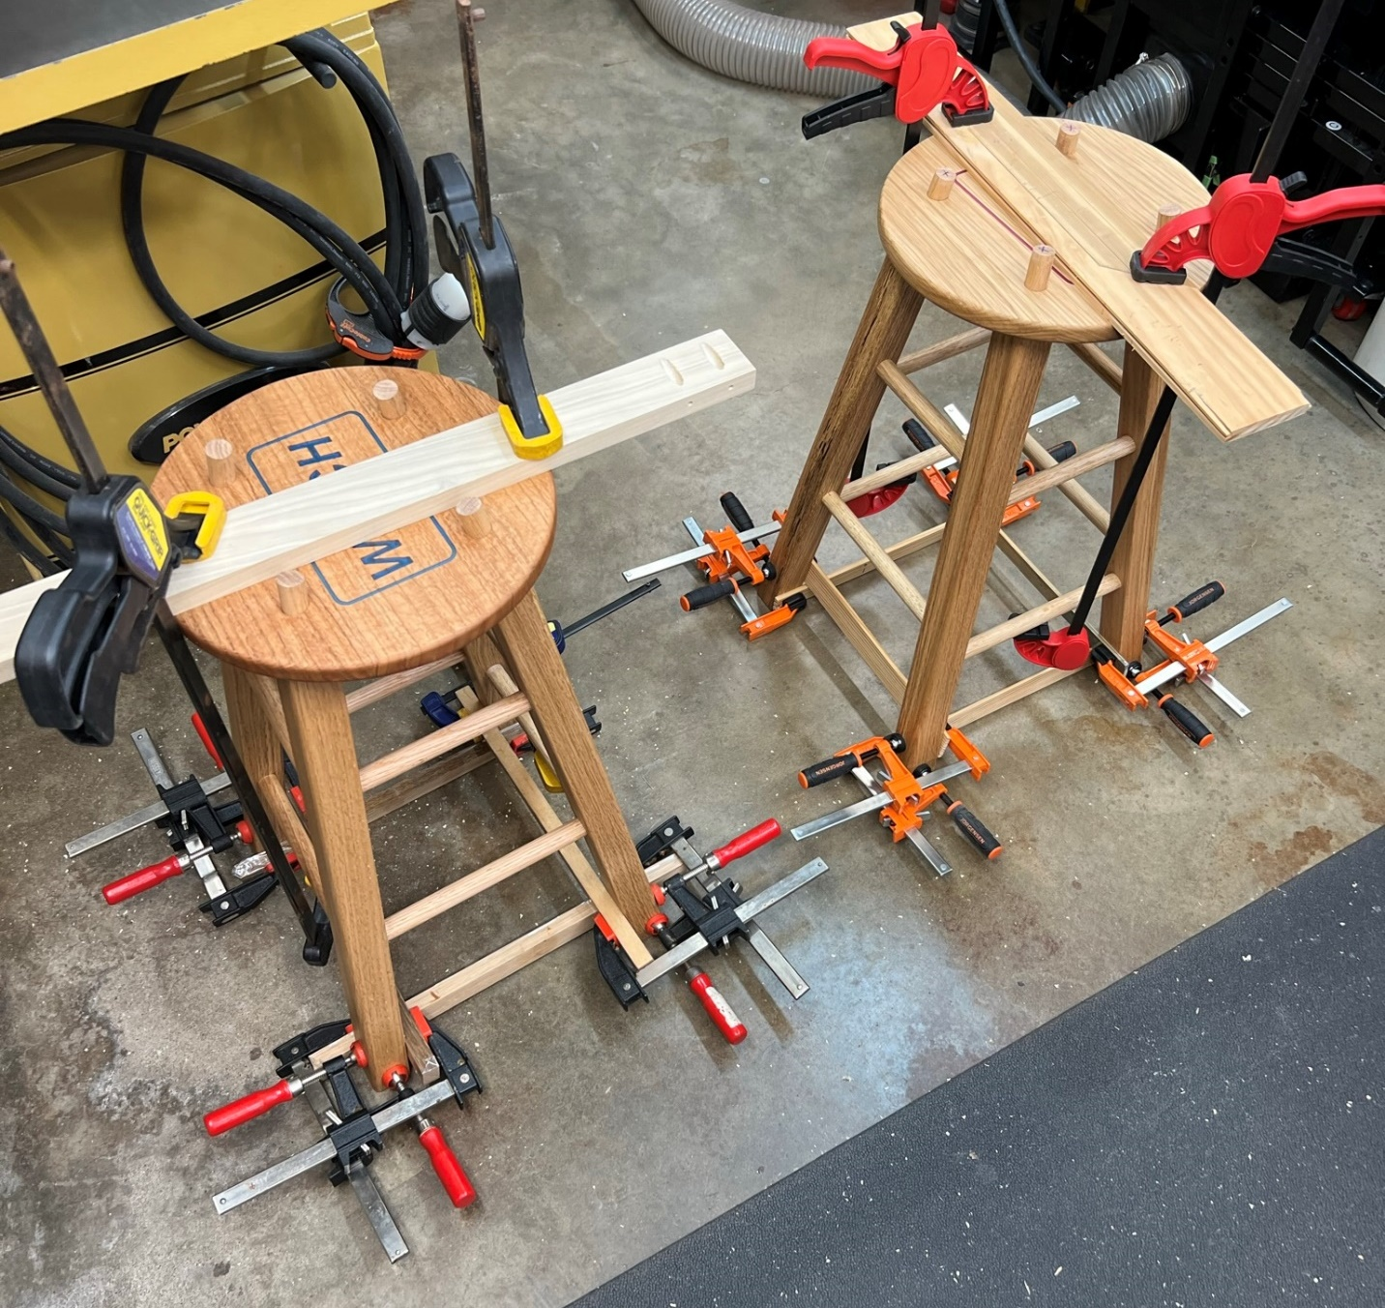
Glued-up and Clamped

Slide 18
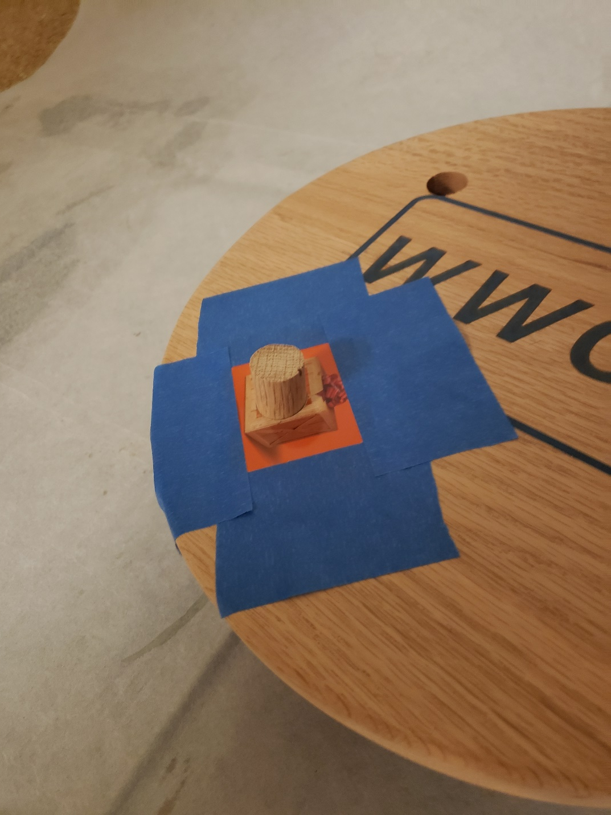
Seat Dowels

Slide 19
Two Shop Stools

Slide 20
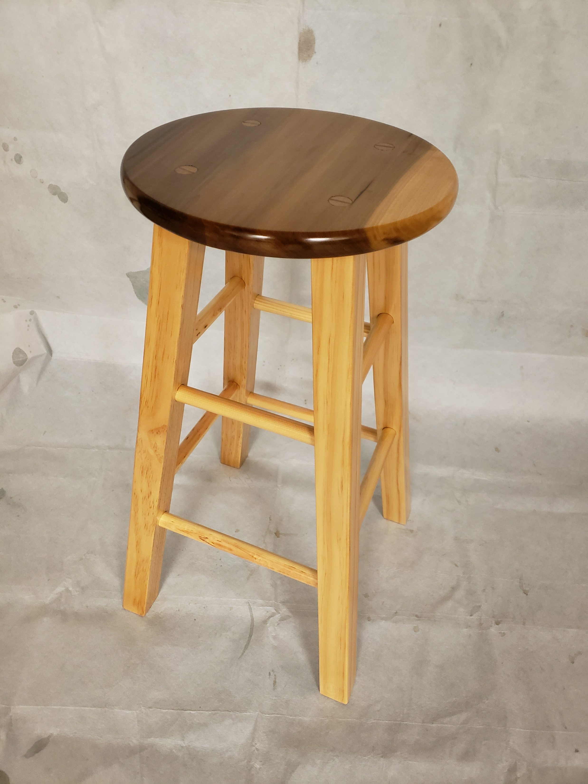
Test unit “Trust, but verify”

Slide 21
Two Shop Stools

