Slide 1
Secret Door Bookcases

Slide 2
Why Secret Door Bookcases?
Conceals a room or closet-a form of security
Creates Useful Space from a Doorway
They Are Fun!
Not Always a bookcase-spice racks, tie and belt racks, mirrors, ticket booth and flat wall panels

Slide 3
Two Types- “Innie” and “Outie”
Inward swinging doors are easier to conceal with molding
Inward 90 degree swing must account for thickness of door
Best is 180 degree swing-clears entire opening
Outward swings into the room you are standing in
Much harder to conceal-molding or hinges become visible

Slide 4
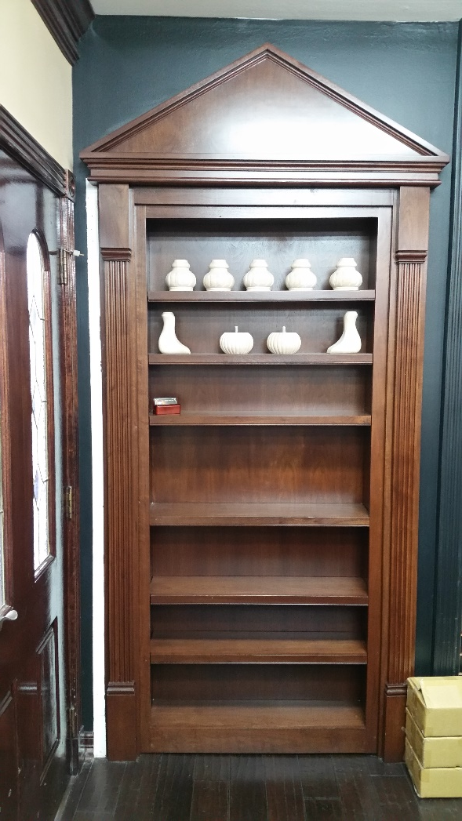
Inward Swinging Door

Slide 5
Inward Swinging Door Drawing

Slide 6
Outward Swinging Door

Slide 7
Types of Pivots
Door Hinges-heavy duty ball bearing commercial
Soss hinges
Piano hinges-knuckle is visible
Pivots-one upper, one lower. Difficult to install on concrete floors, tricky to adjust
Type of pivot must be able to carry hundreds of pounds
Hinges must usually be secured to house frame, not jamb

Slide 8
Double Sided Door Kitchen-Study

Slide 9
Narrow Doorway

Slide 10
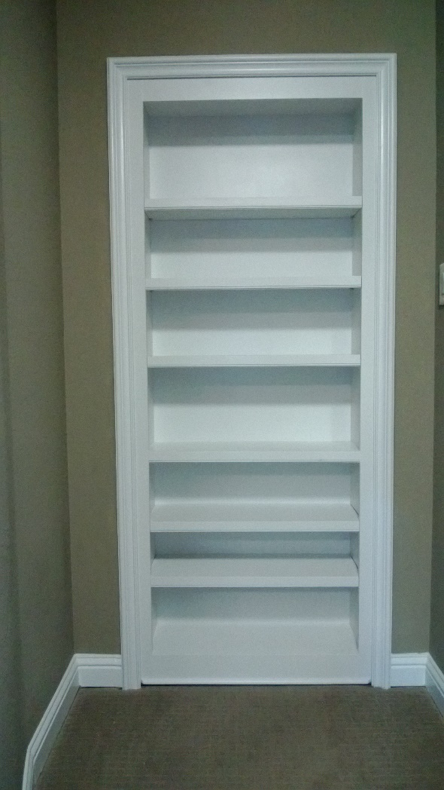
Narrow Doorway Installed

Slide 11
Gun Closet

Slide 12
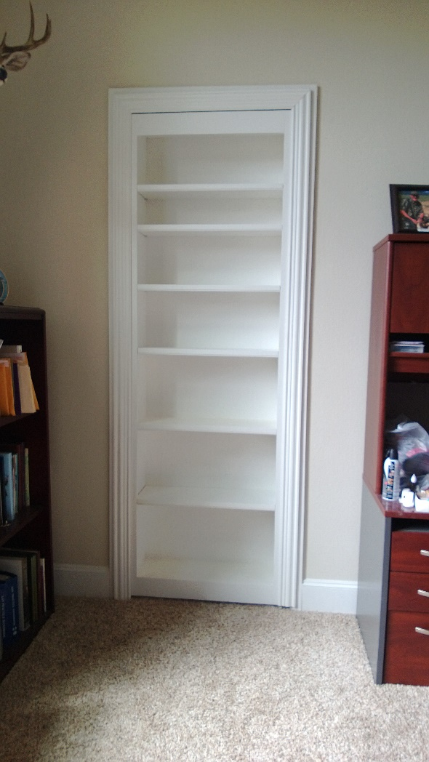
Single Pivot Outward Swinging Door

Slide 13
Structure-Casework
Racking under load
Badly built or installed will break or scratch the floor
Bookcase carcass is double strength

Slide 14
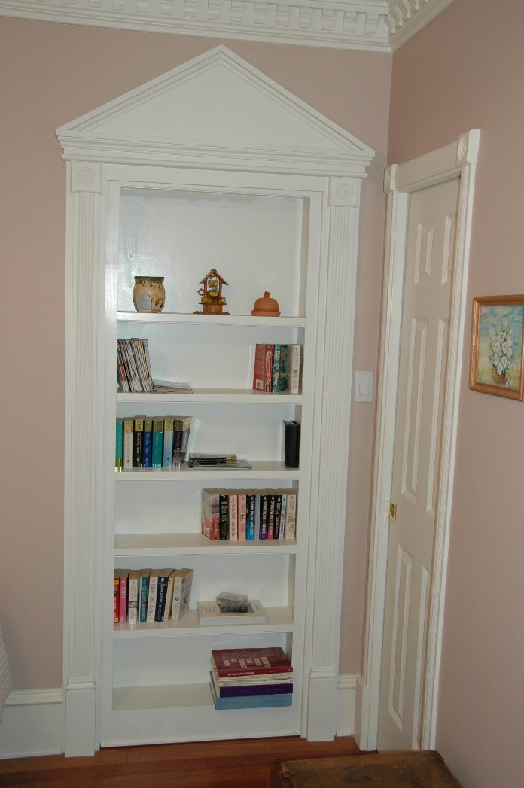
90 Degree Inward Swing

Slide 15
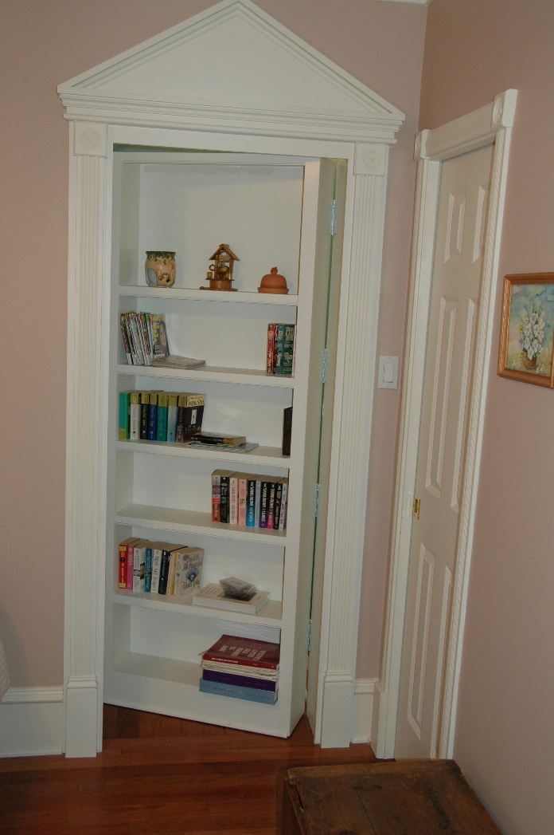
90 Degree Partial Open

Slide 16
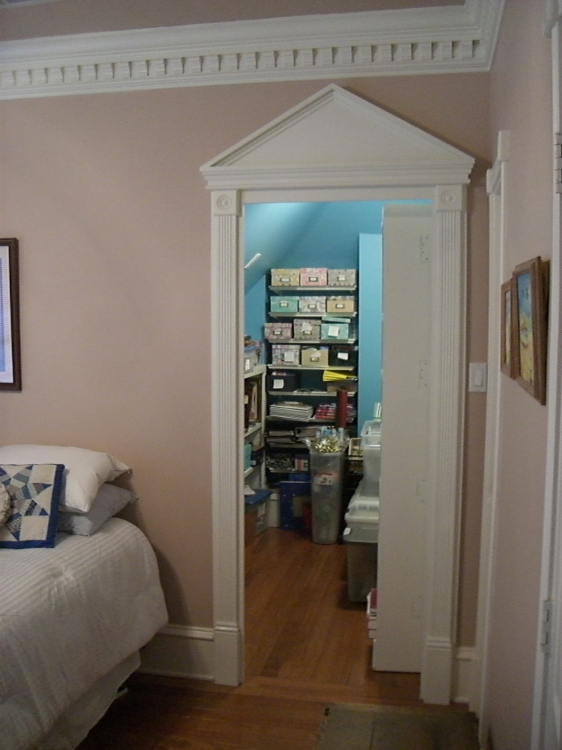
90 Degree Full Open

Slide 17
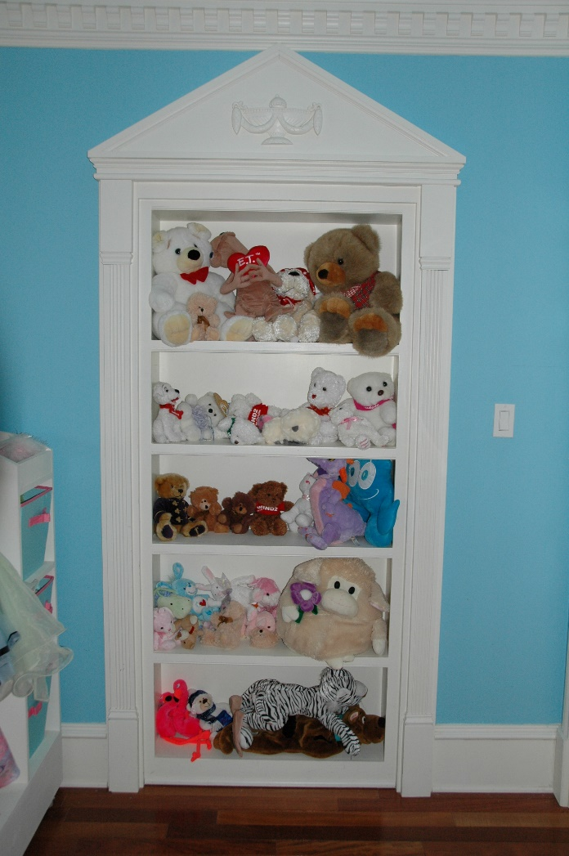
180 Degree Door

Slide 18
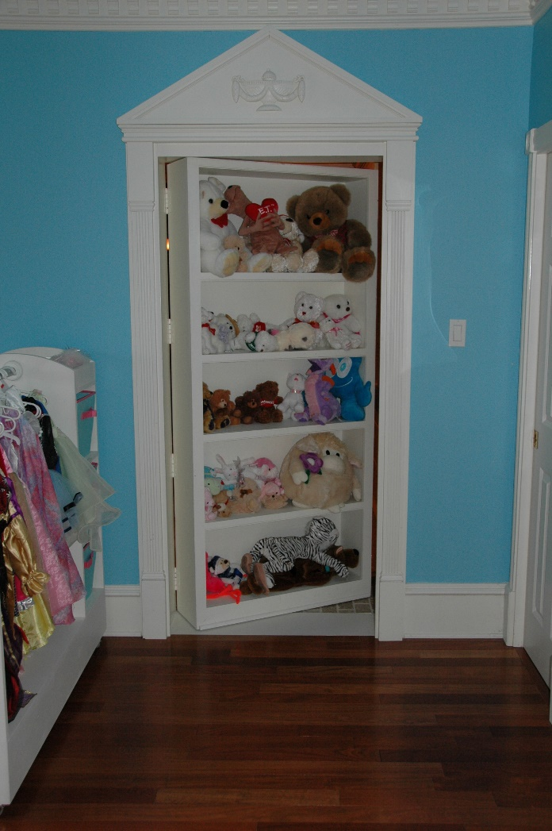
180 Degree Partial Open

Slide 19
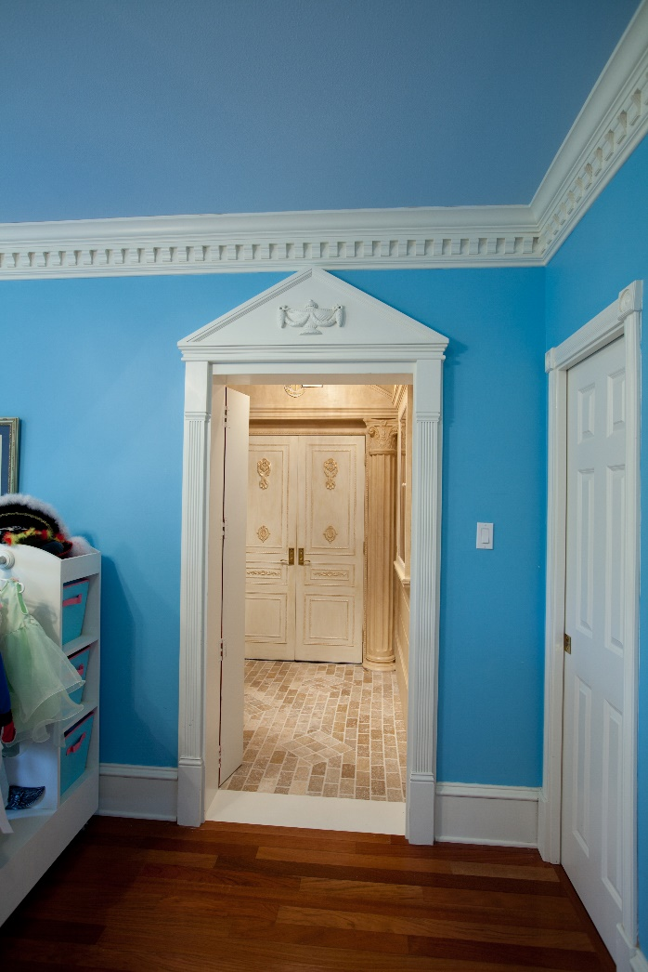
180 Degree Door Fully Open

Slide 20
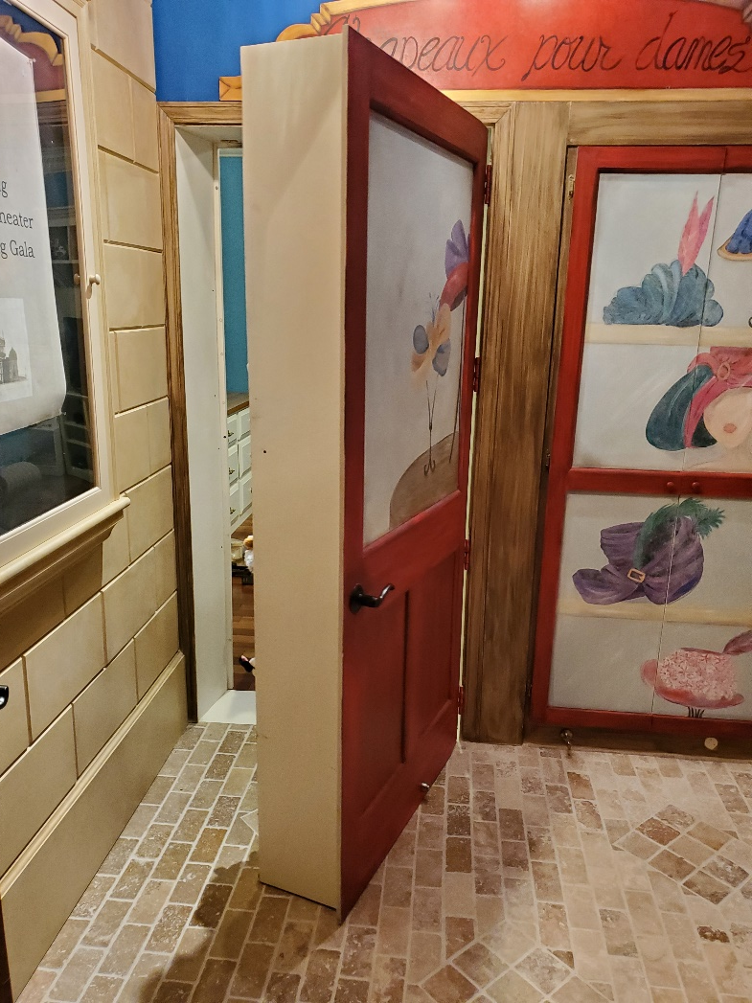
180 Degree Door From Inside

Slide 21
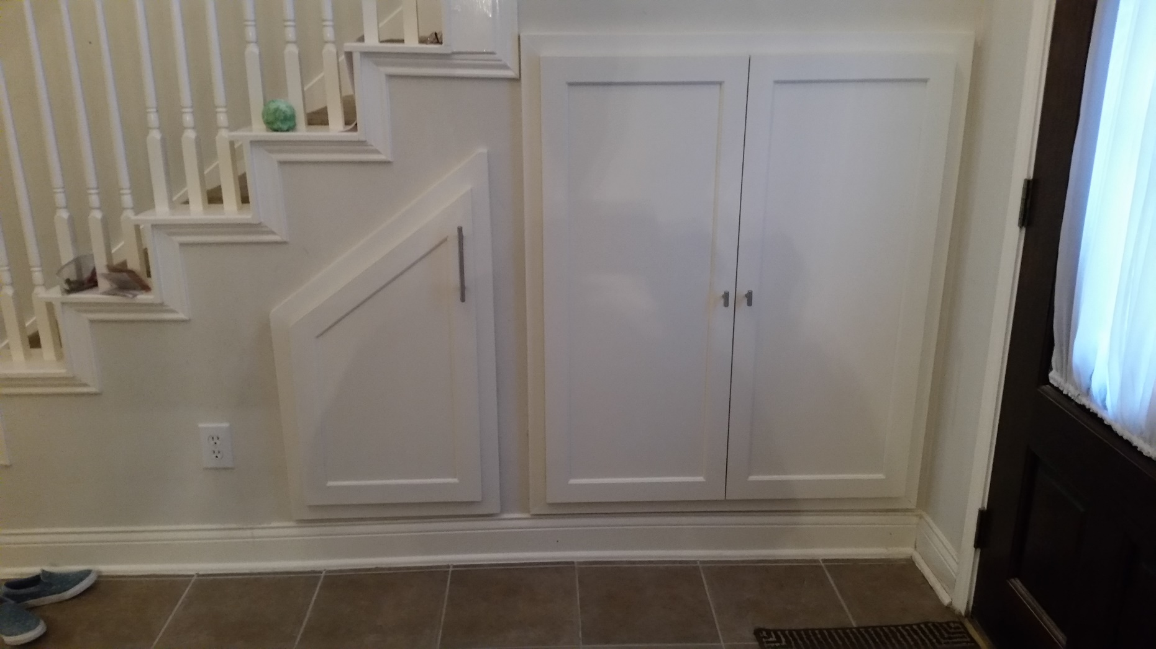
Shoe Storage

Slide 22
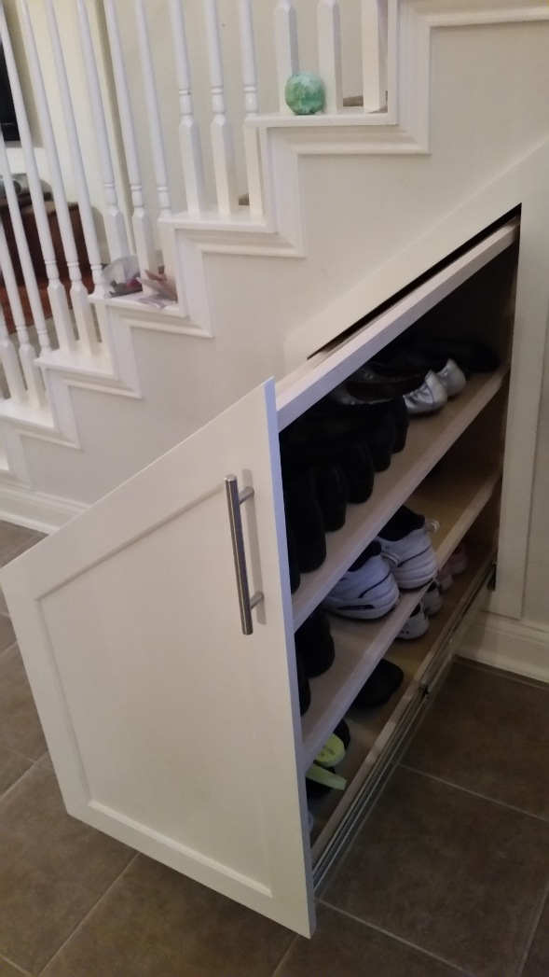
Pullout Shoe Drawer

Slide 23
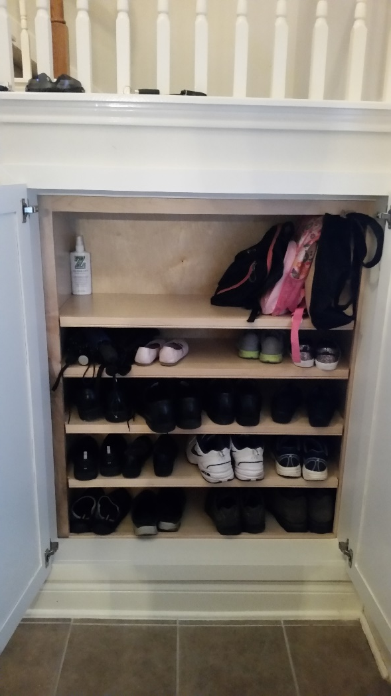
Shoe Storage

Slide 24
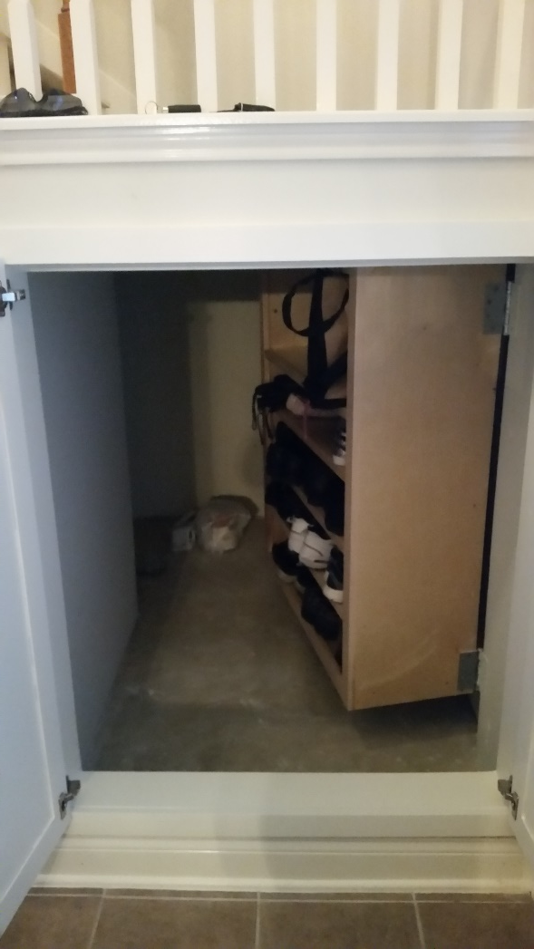
Shoe Storage Open

Slide 25
Structure-Jamb
Bevel the jamb, not the case-less visible
Bevel is huge with 10” deep door
If you will see both sides of the door, may cover the gap with molding attached to the door
May extend wall to depth of door- 10” wall instead of 4”
Typically hinges on “innies” need to be at the back of the case

Slide 26
Bookcase Hinged Mid Side

Slide 27
Closures
Ball Catches
Magnets
Velcro-typically used for panels removed only occasionally
Locks-panic rooms. Simple pin can work.

Slide 28
Installation
Tricky to install
Often make an exact scale template to locate jamb, hinge
Usually secure to wall framing
May need to extend wall on hinge side
Must be plumb and level in 3 axis
Mount to minimize gap at floor-target 1/8”
Plan for helper-very heavy casework
Install catch last

Slide 29
Non-Bookcase Secret Doors
Shallow kitchen cabinets-spice racks
Mirror
Tie/Belt Rack
Ticket Booth
Flat Doors or Panels
Cabinets that move-Fridge cabinet, entertainment center

Slide 30
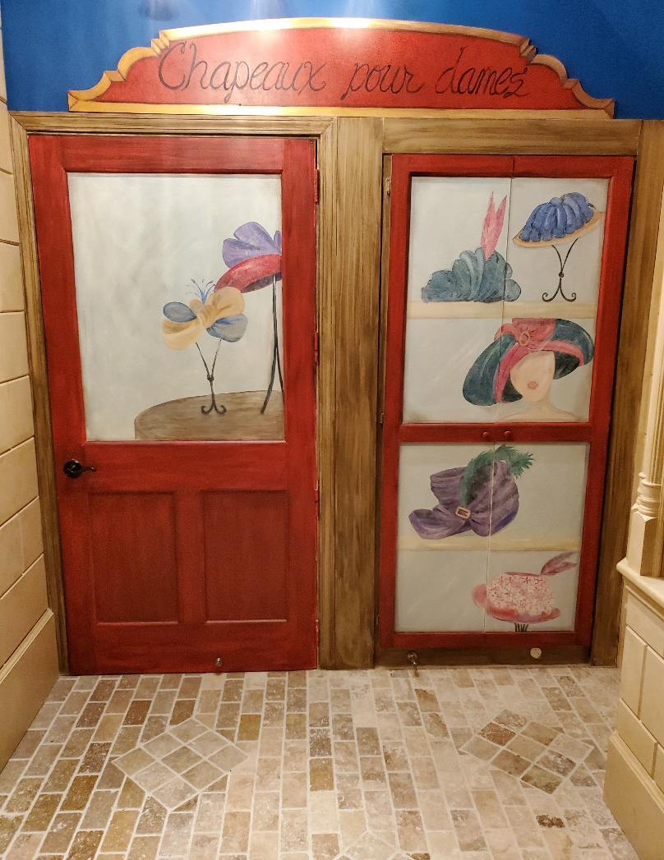
Hidden Panel Doors

Slide 31
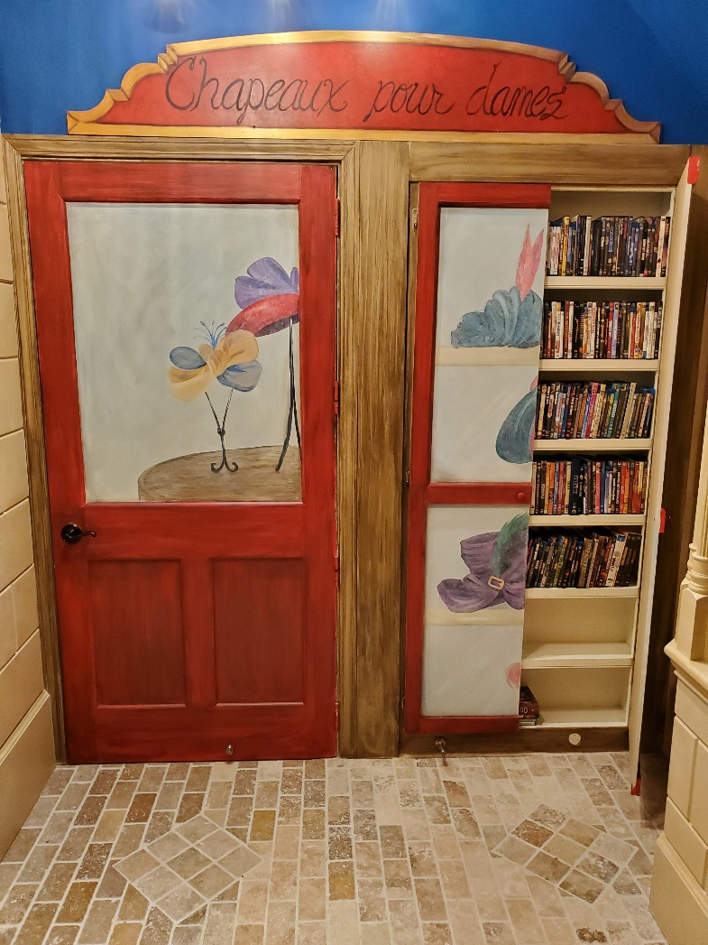
Hidden Panel Doors Open

Slide 32
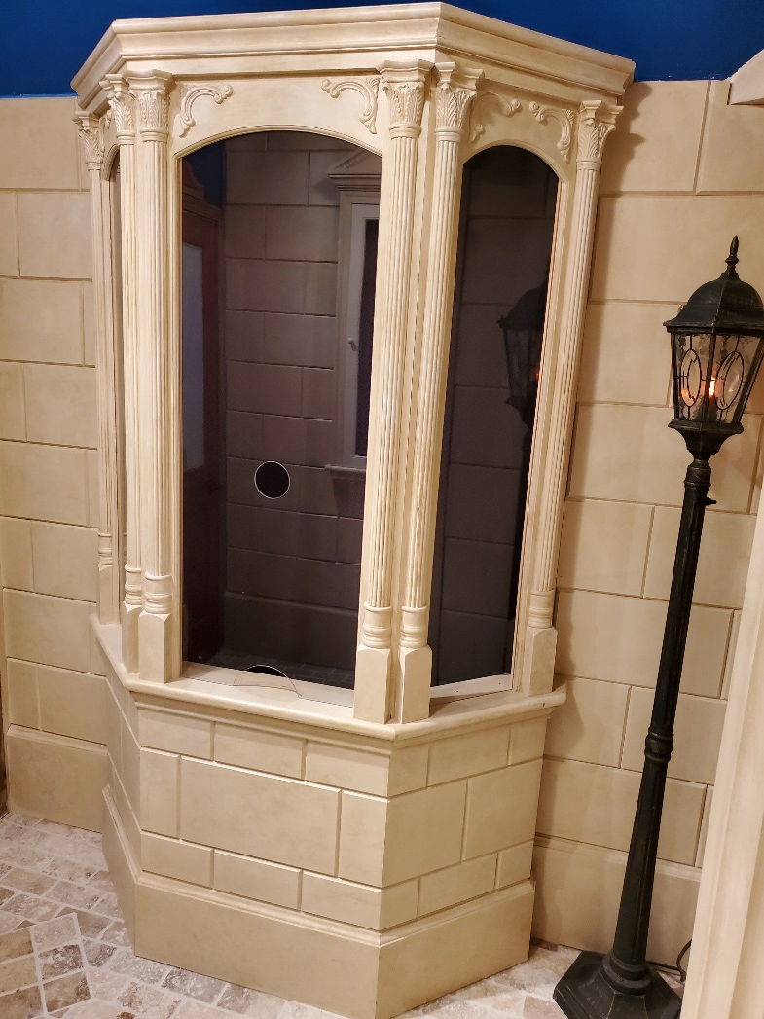
Ticket Booth

Slide 33
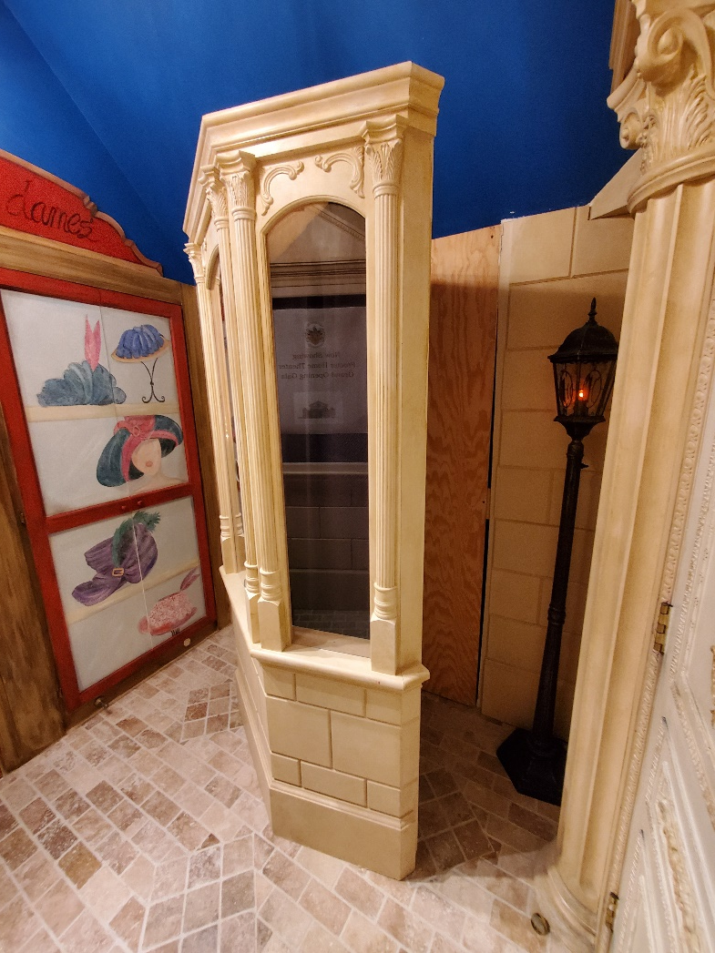
Ticket Booth Open

Slide 34
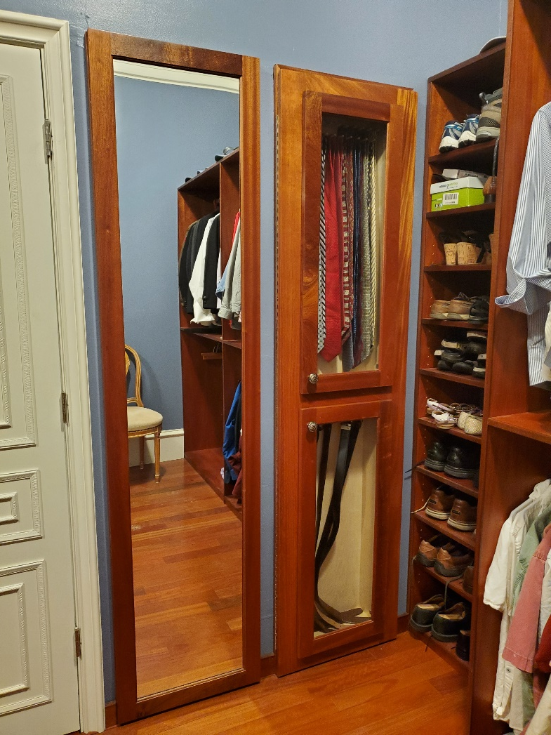
Master Closet

Slide 35
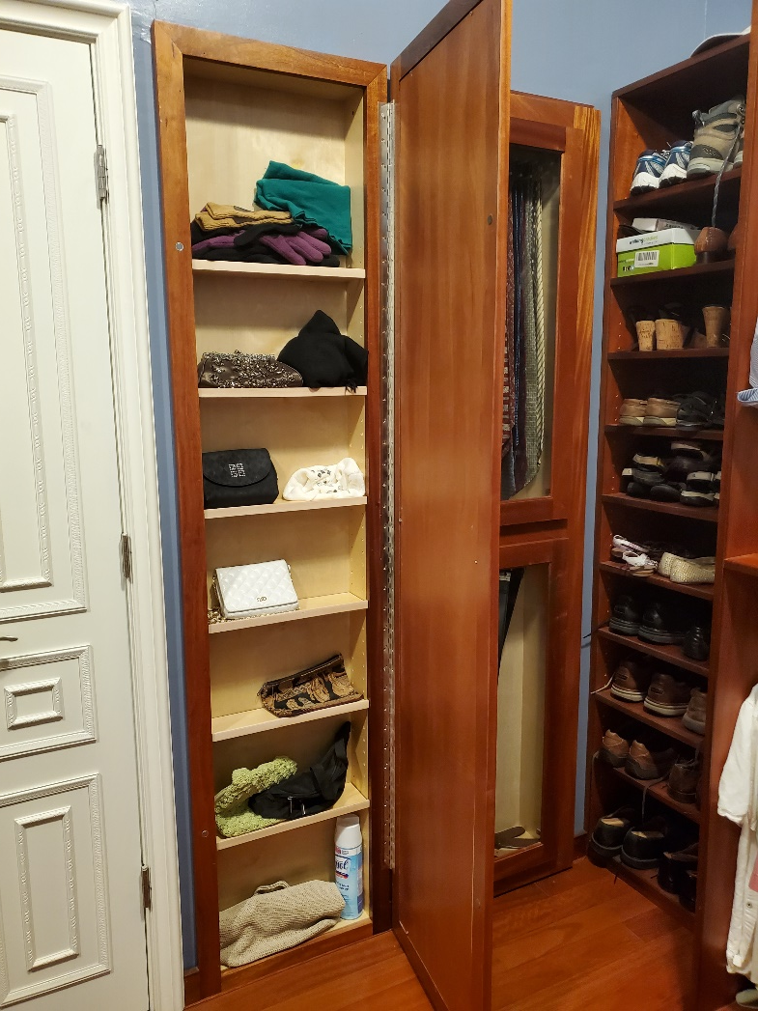
Mirror Door

Slide 36
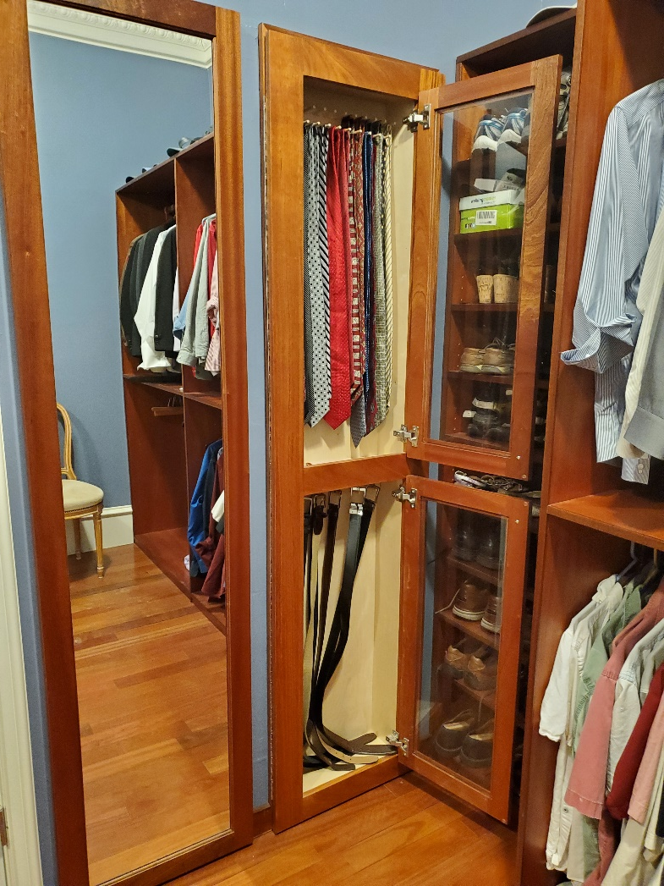
Tie and Belt Rack

Slide 37
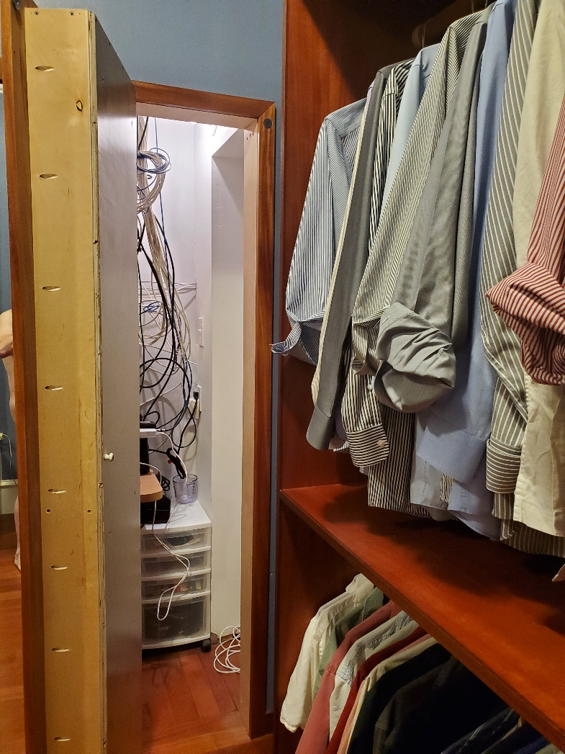
Tie & Belt Rack Open

Slide 38
Cabinetry With A Secret
Cabinetry can change or conceal an opening
Cabinetry can look built in but actually move

Slide 39
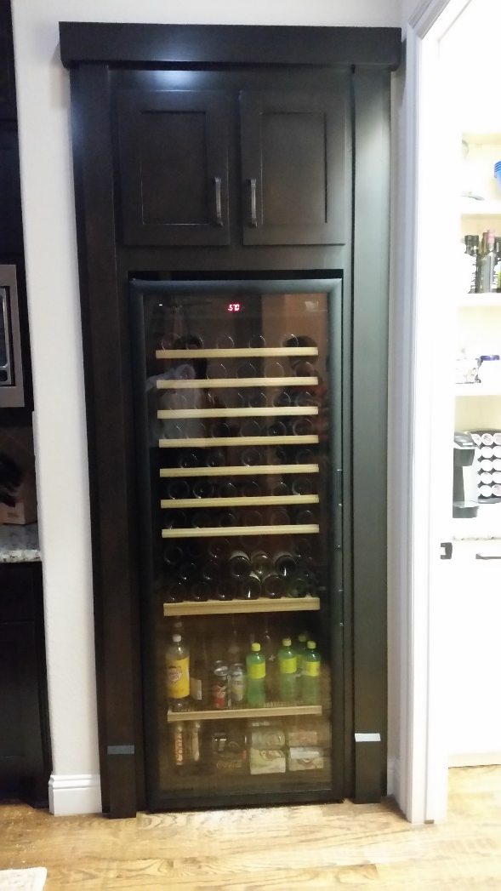
Non-Opening Façade Around Wine Cooler

Slide 40
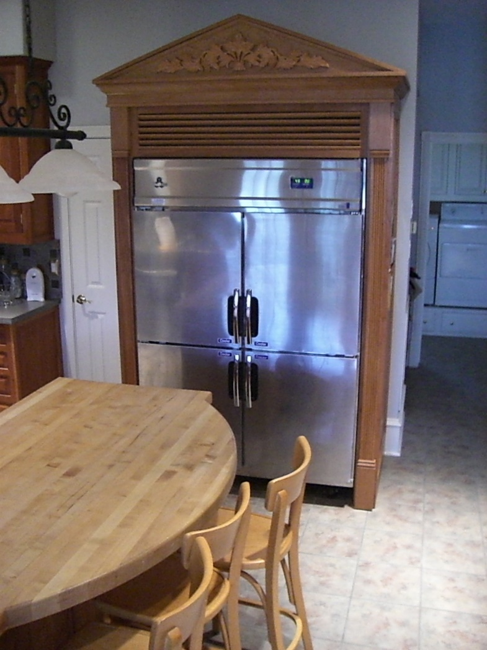
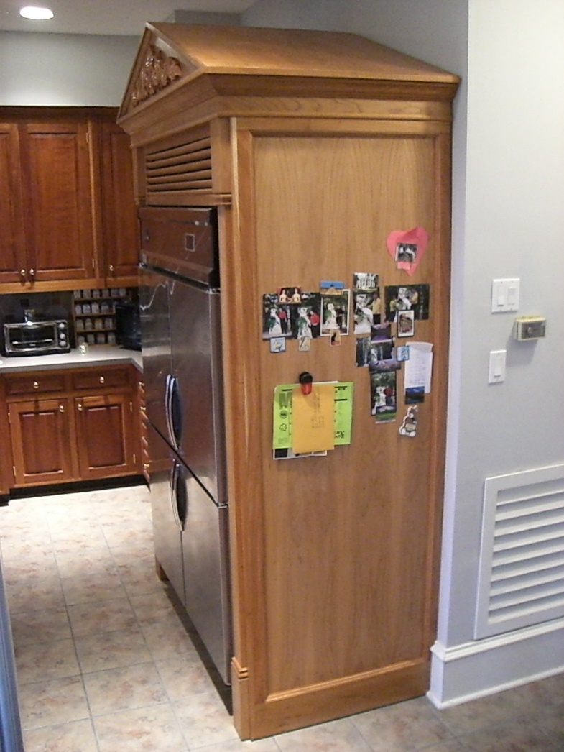
Fridge Cabinet Slides Forward

Slide 41
Examples of Work
Hardwood Products Showroom
Client Kitchen Spice Rack
Client Bookcases concealing gun rooms or safes
Client Bookcase conceals stairway
Client Understair Shoe Rack Swings to Access Storage

